Slide 1
Lattice-based Cryptography
Emmanuel H. Otacan

Slide 2
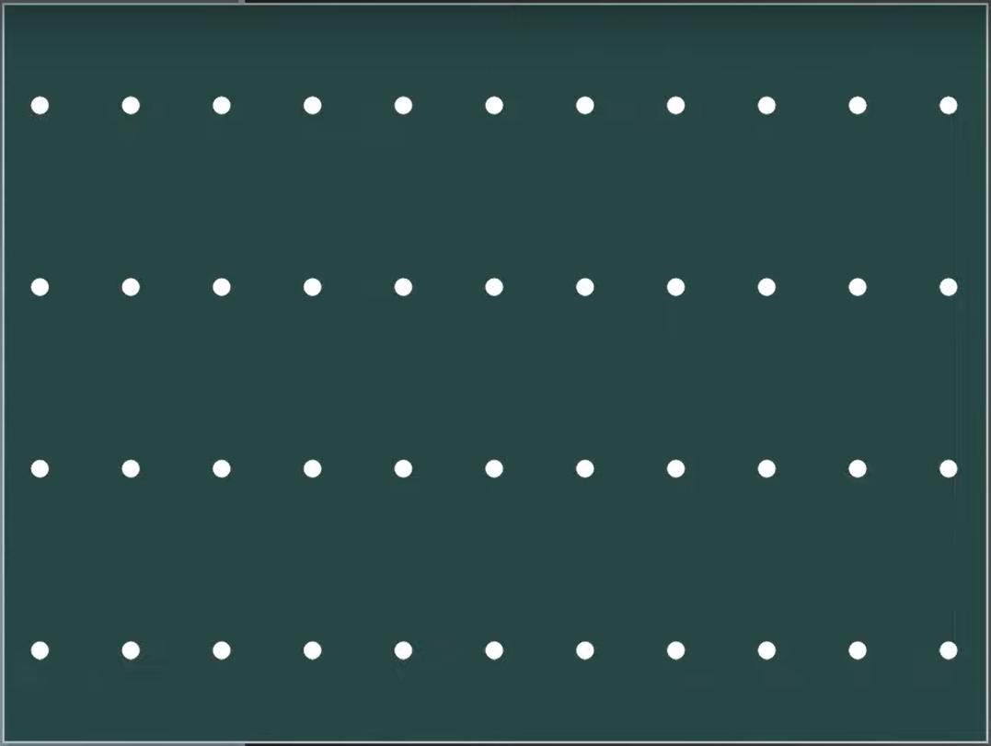
This is a Lattice

Slide 3
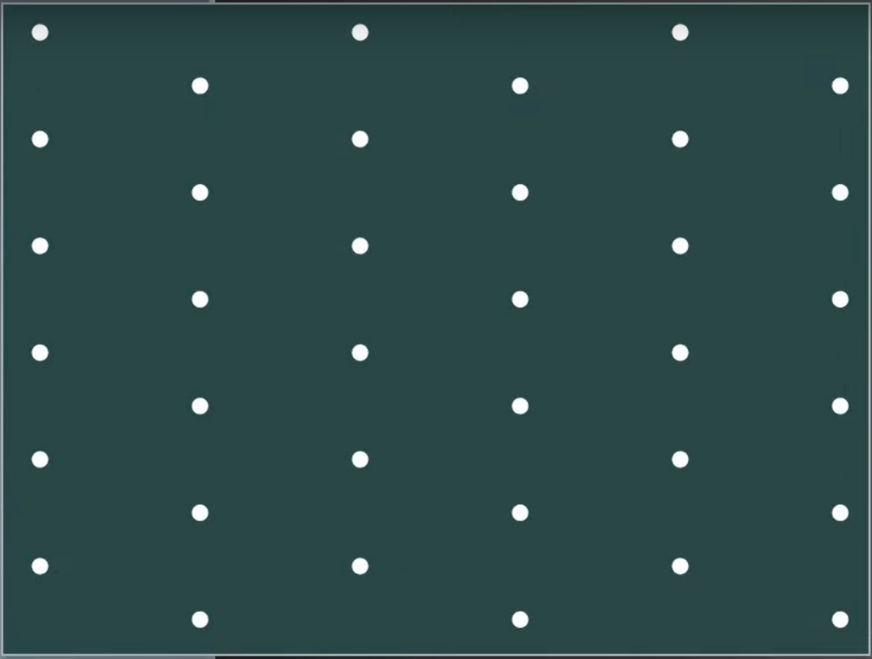
And so is this

Slide 4
A lattice is a discrete set of points that spans a mathematical space in a regular, repeating pattern.

Slide 5
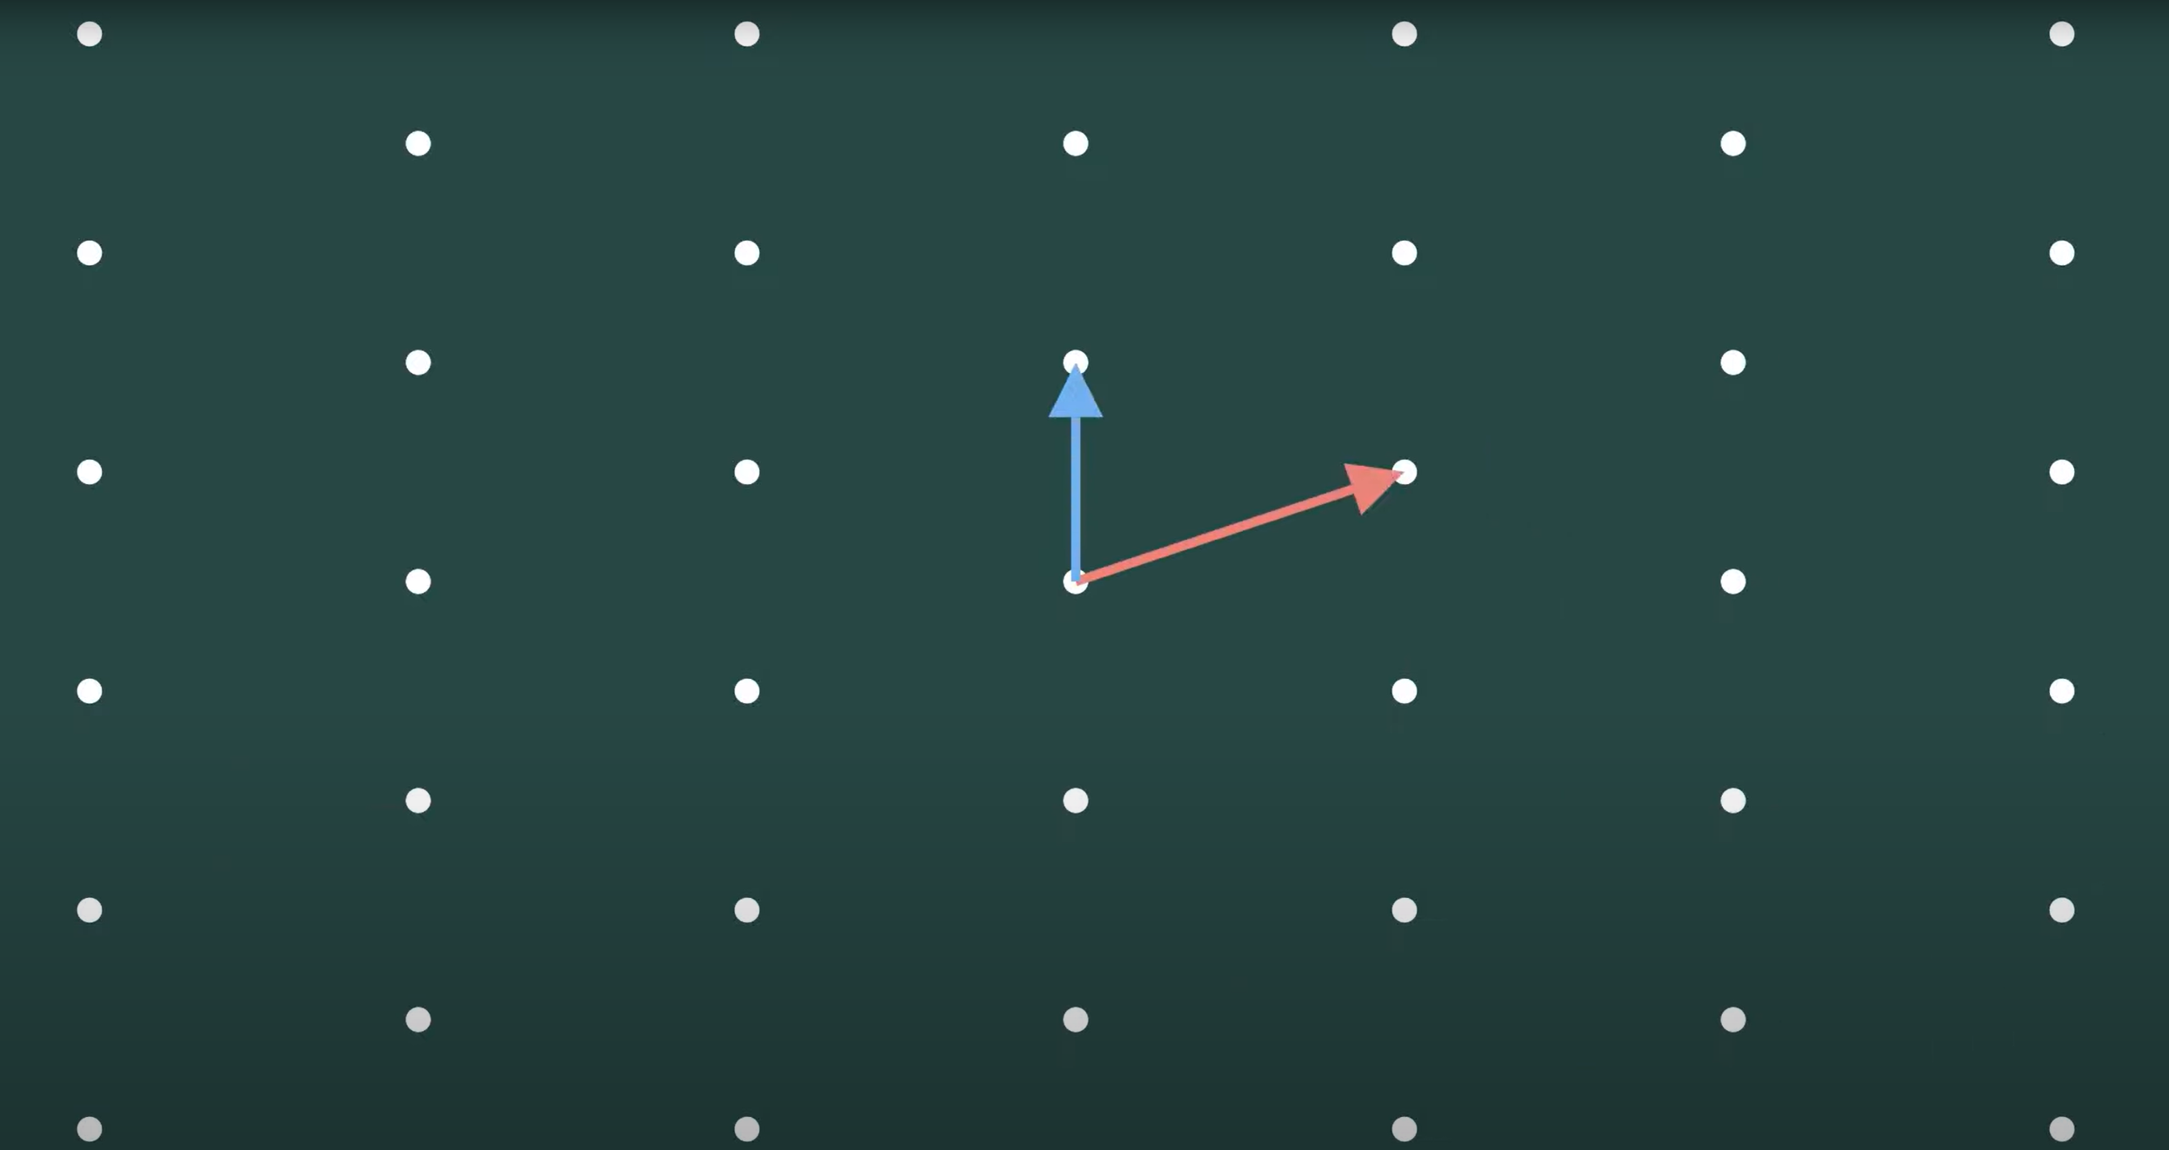
Lattice Vectors
Notes:
Lattices are generated by these two arrows called the vectors
This two-dimensional lattice is generated or created by these two vectors or arrows.

Slide 6
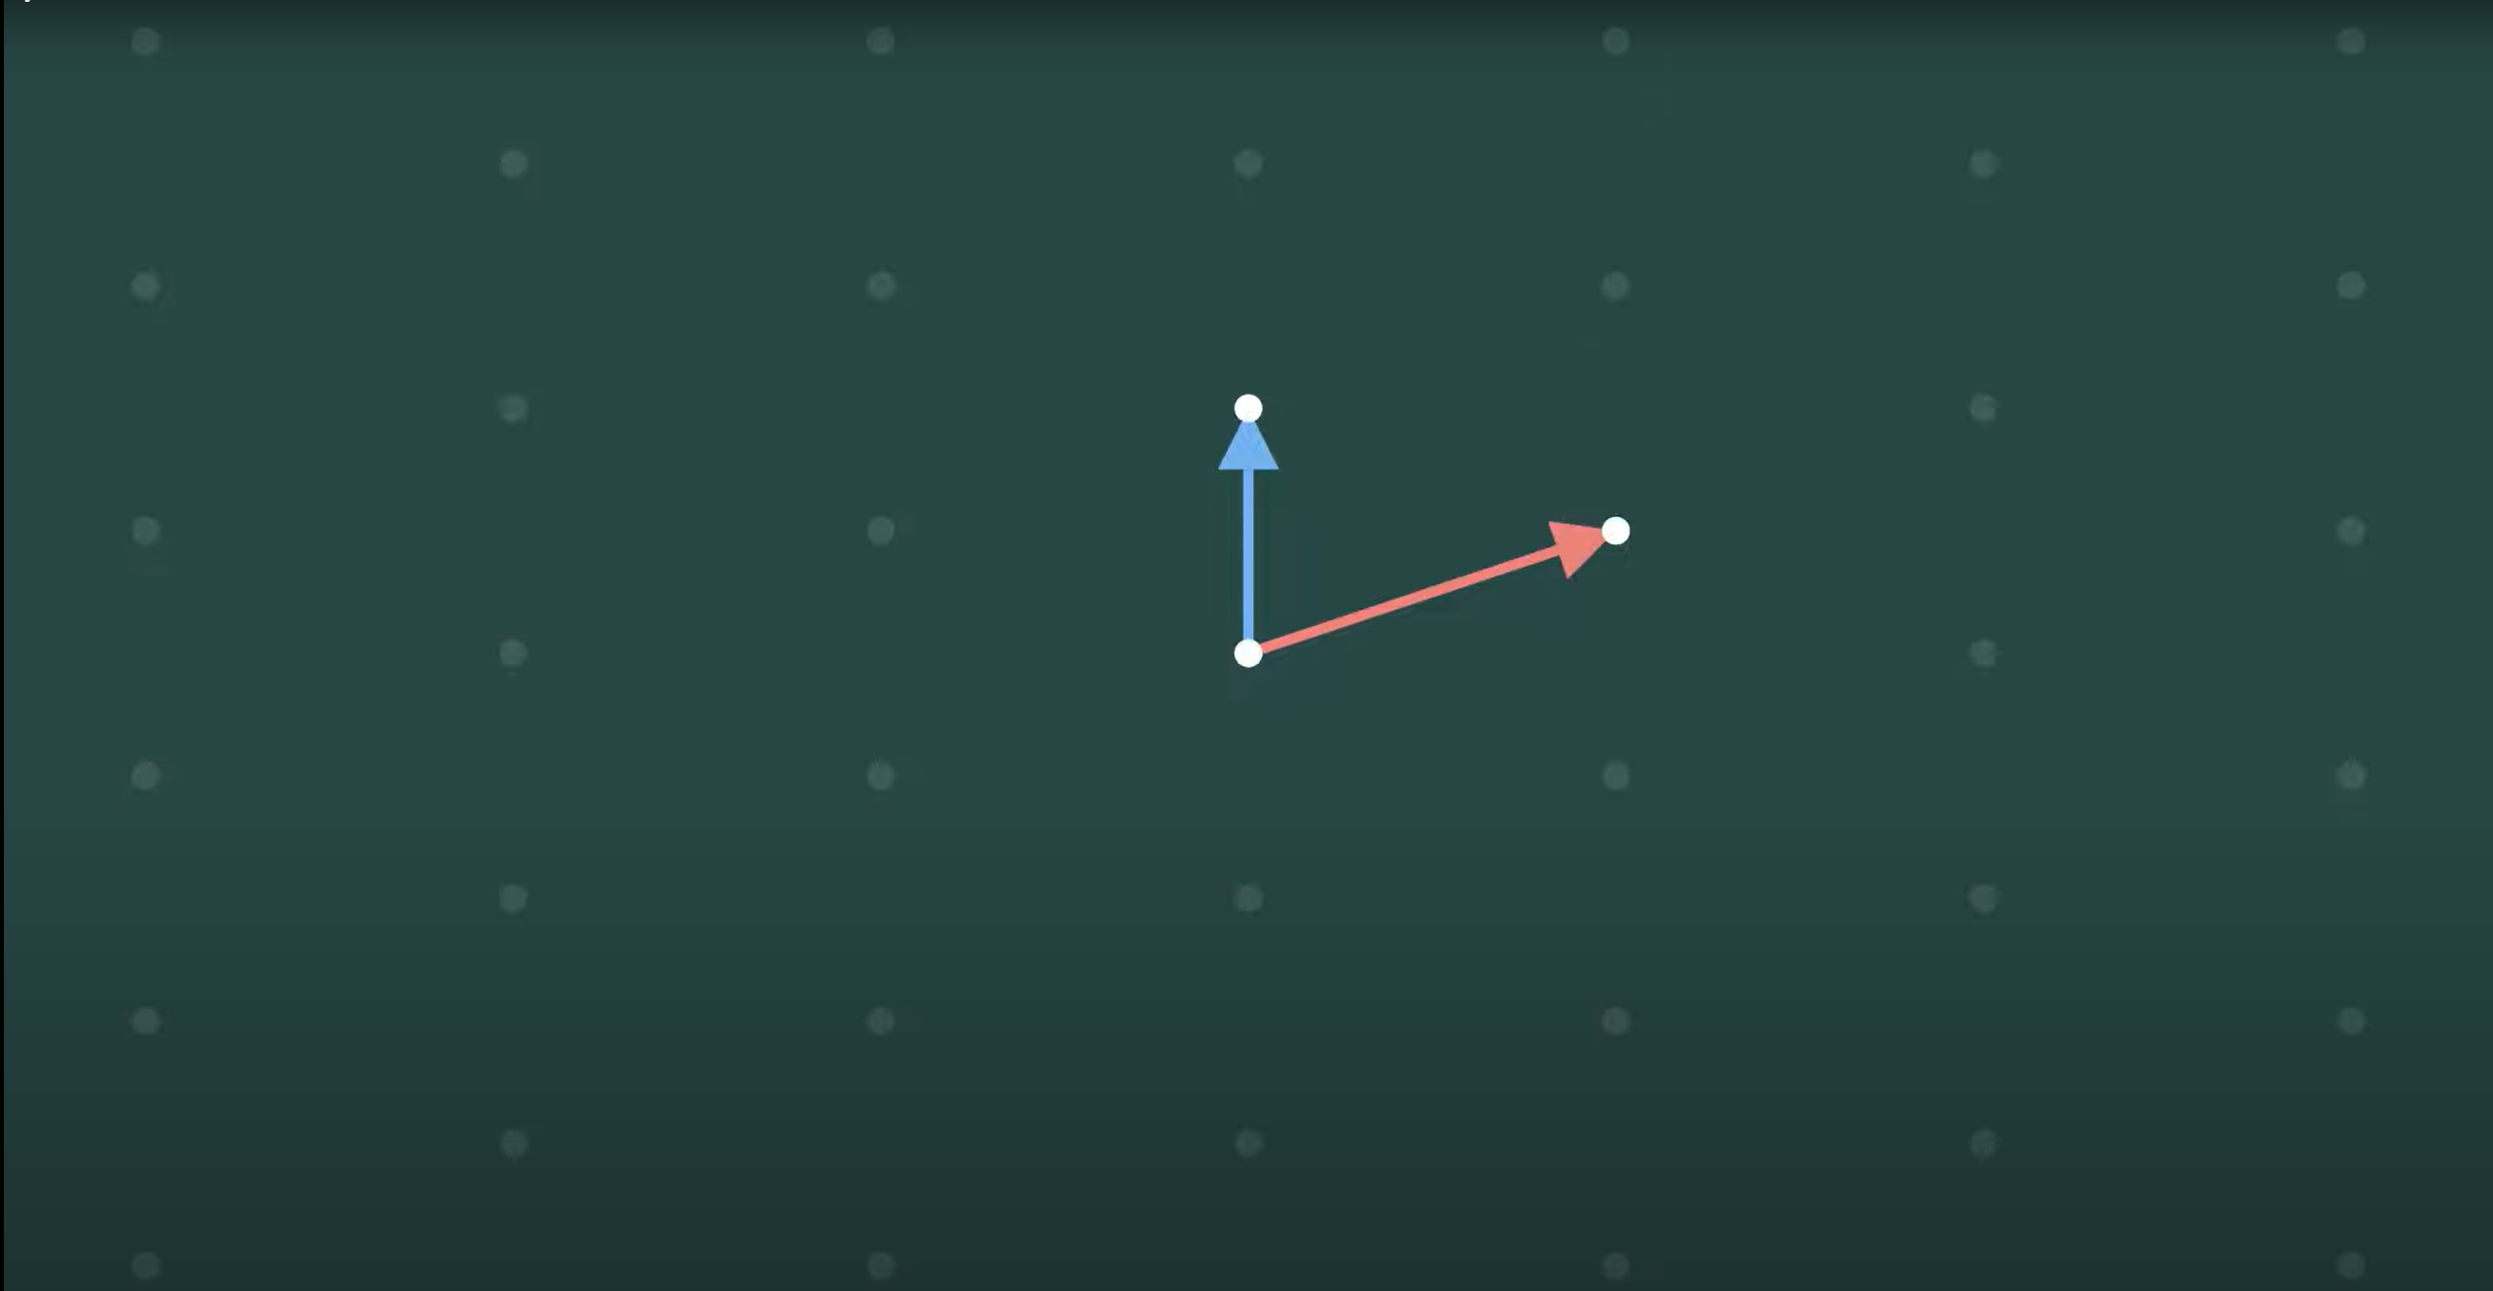
How lattices created?
Notes:
We start with a dot at the origin and dots at the end of each basis vector.

Slide 7
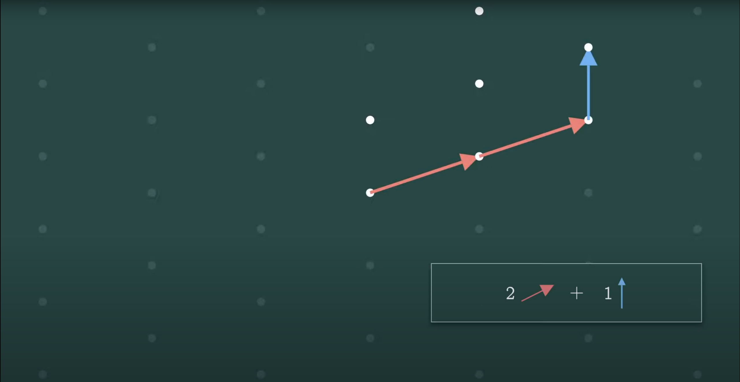
From there, we build. (vector snakes)
Notes:
We lay down the vectors like dominos to build paths starting from the origin
And the lattice is made up of all the points that we can reach with these “vector snakes”
For example, this point is 2 times the red vector plus 1 blue vector

Slide 8
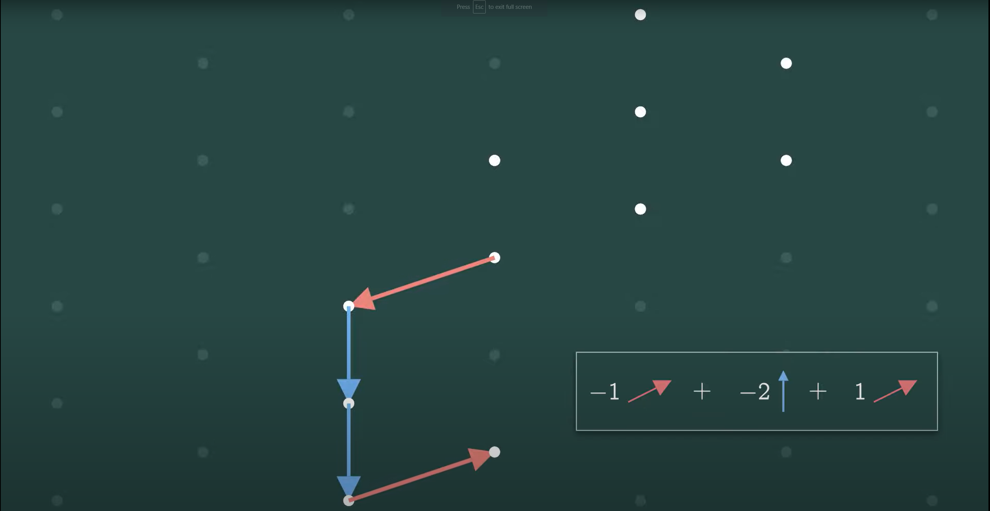
We can stack any number of them together
Notes:
We can describe this point as negative 1 red + negative 2 blue + 1 red.
But we can lump the reds together and then they’ll cross each other out.
Next slide --

Slide 9
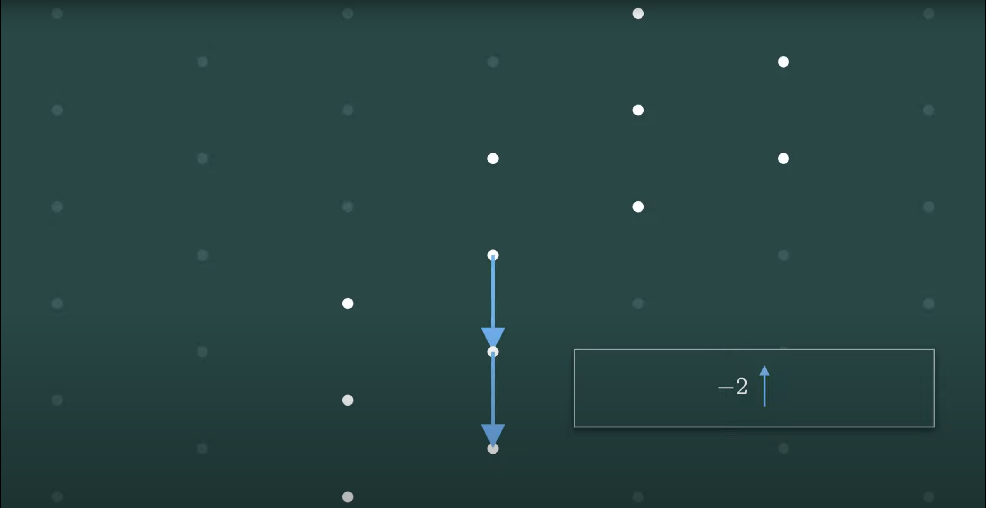
So, it’s just negative two blue

Slide 10
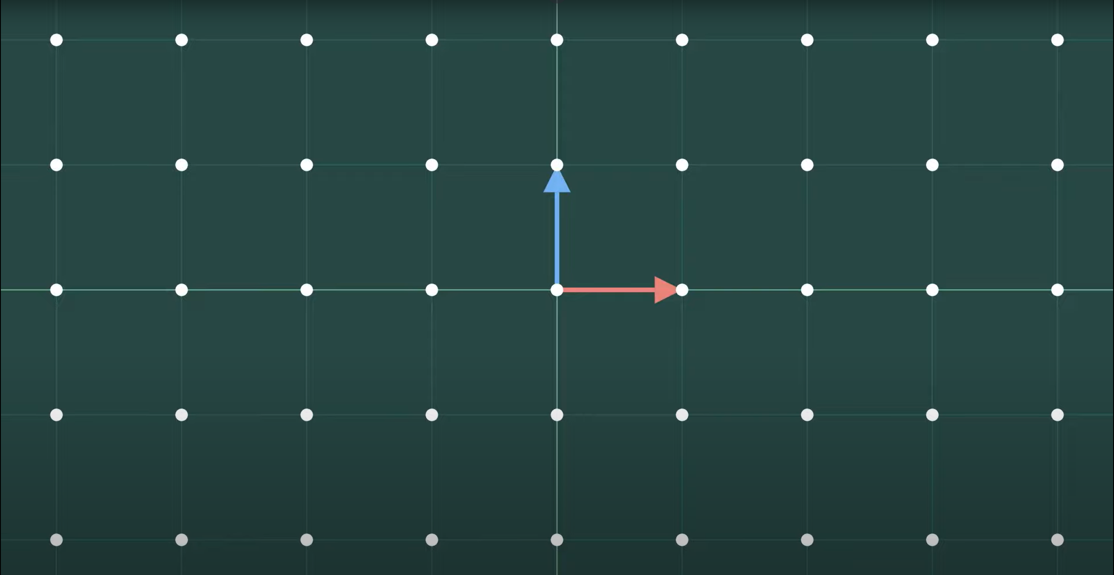
Normal Square Lattice
Notes:
(1, 0) in red and (0, 1) in blue makes up the normal square lattice

Slide 11
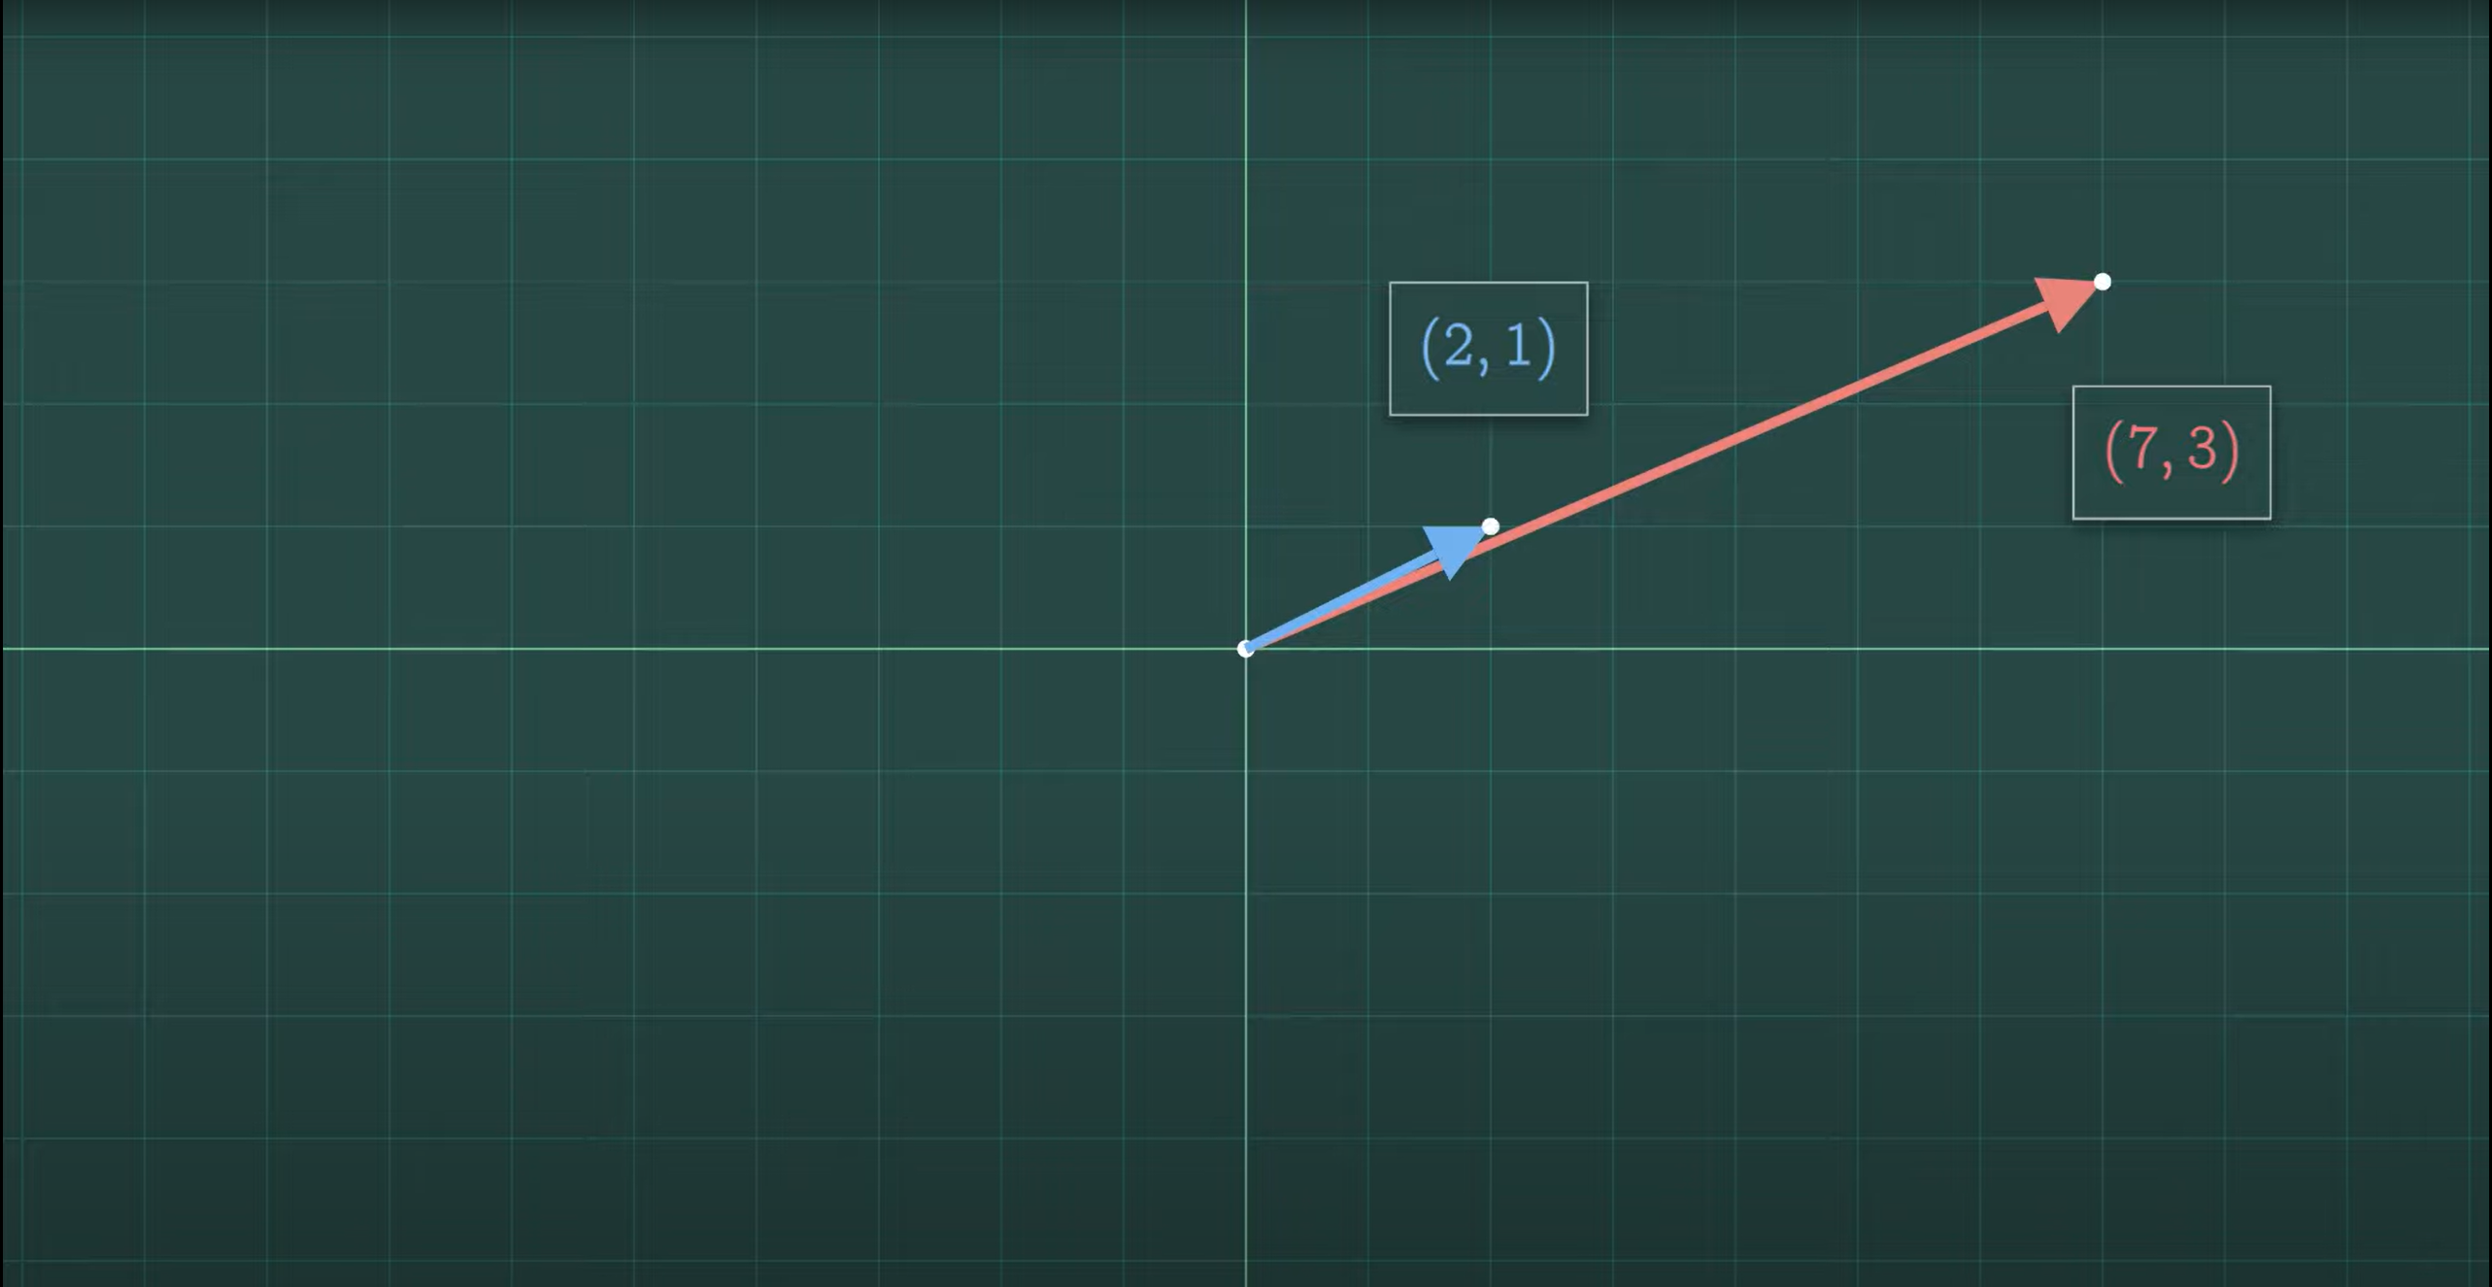

Slide 12
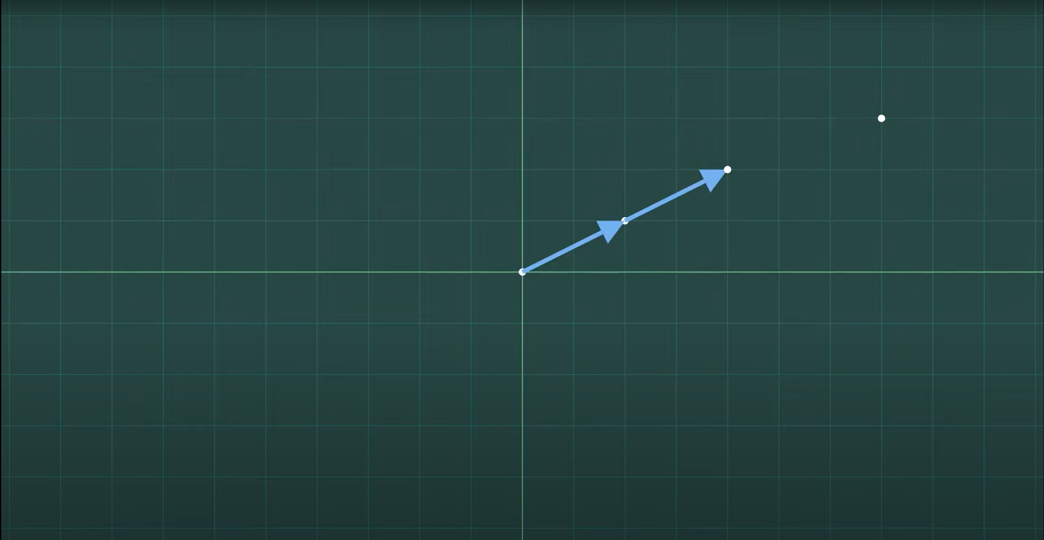
We can add two blue vectors

Slide 13
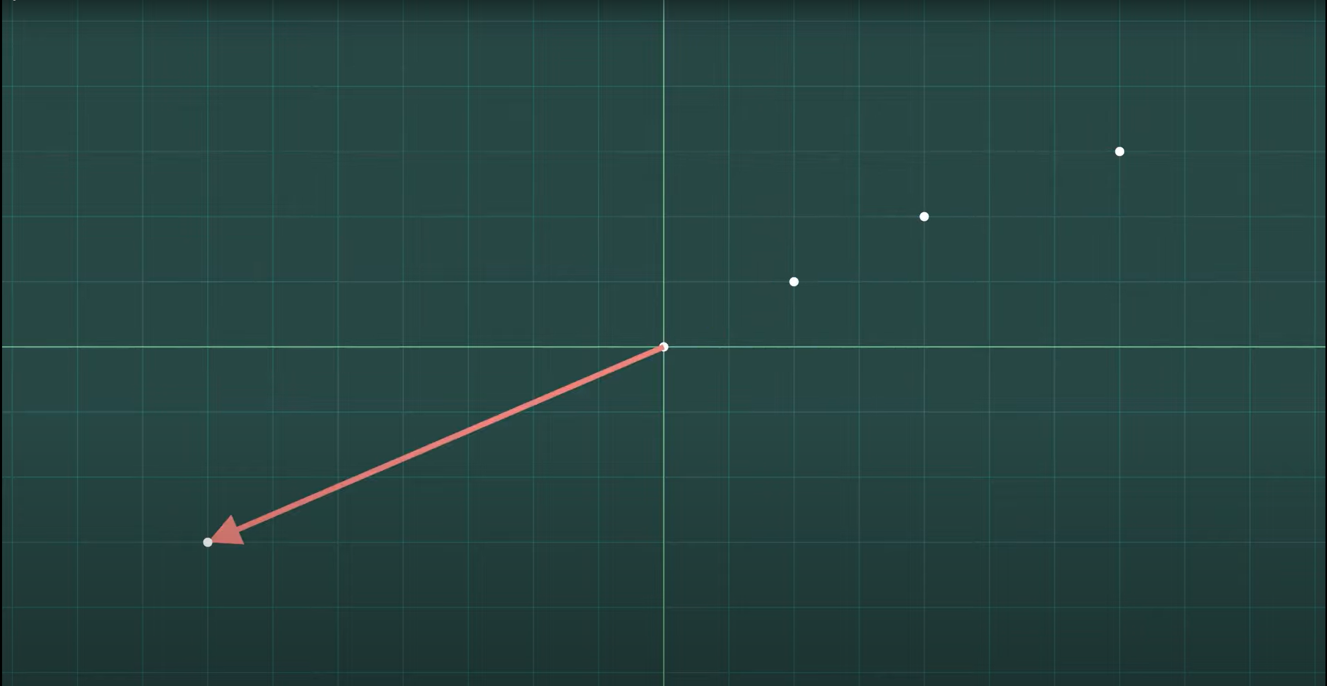
Or just 1 negative red vector

Slide 14
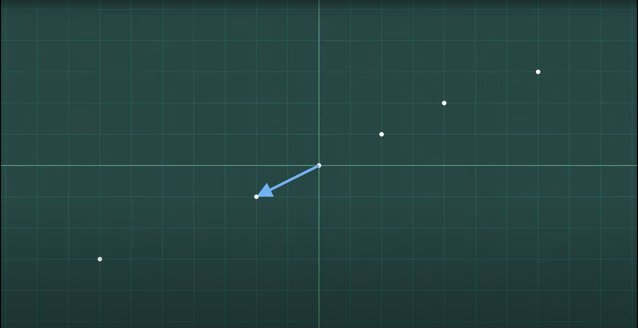
Or just 1 negative blue vector

Slide 15
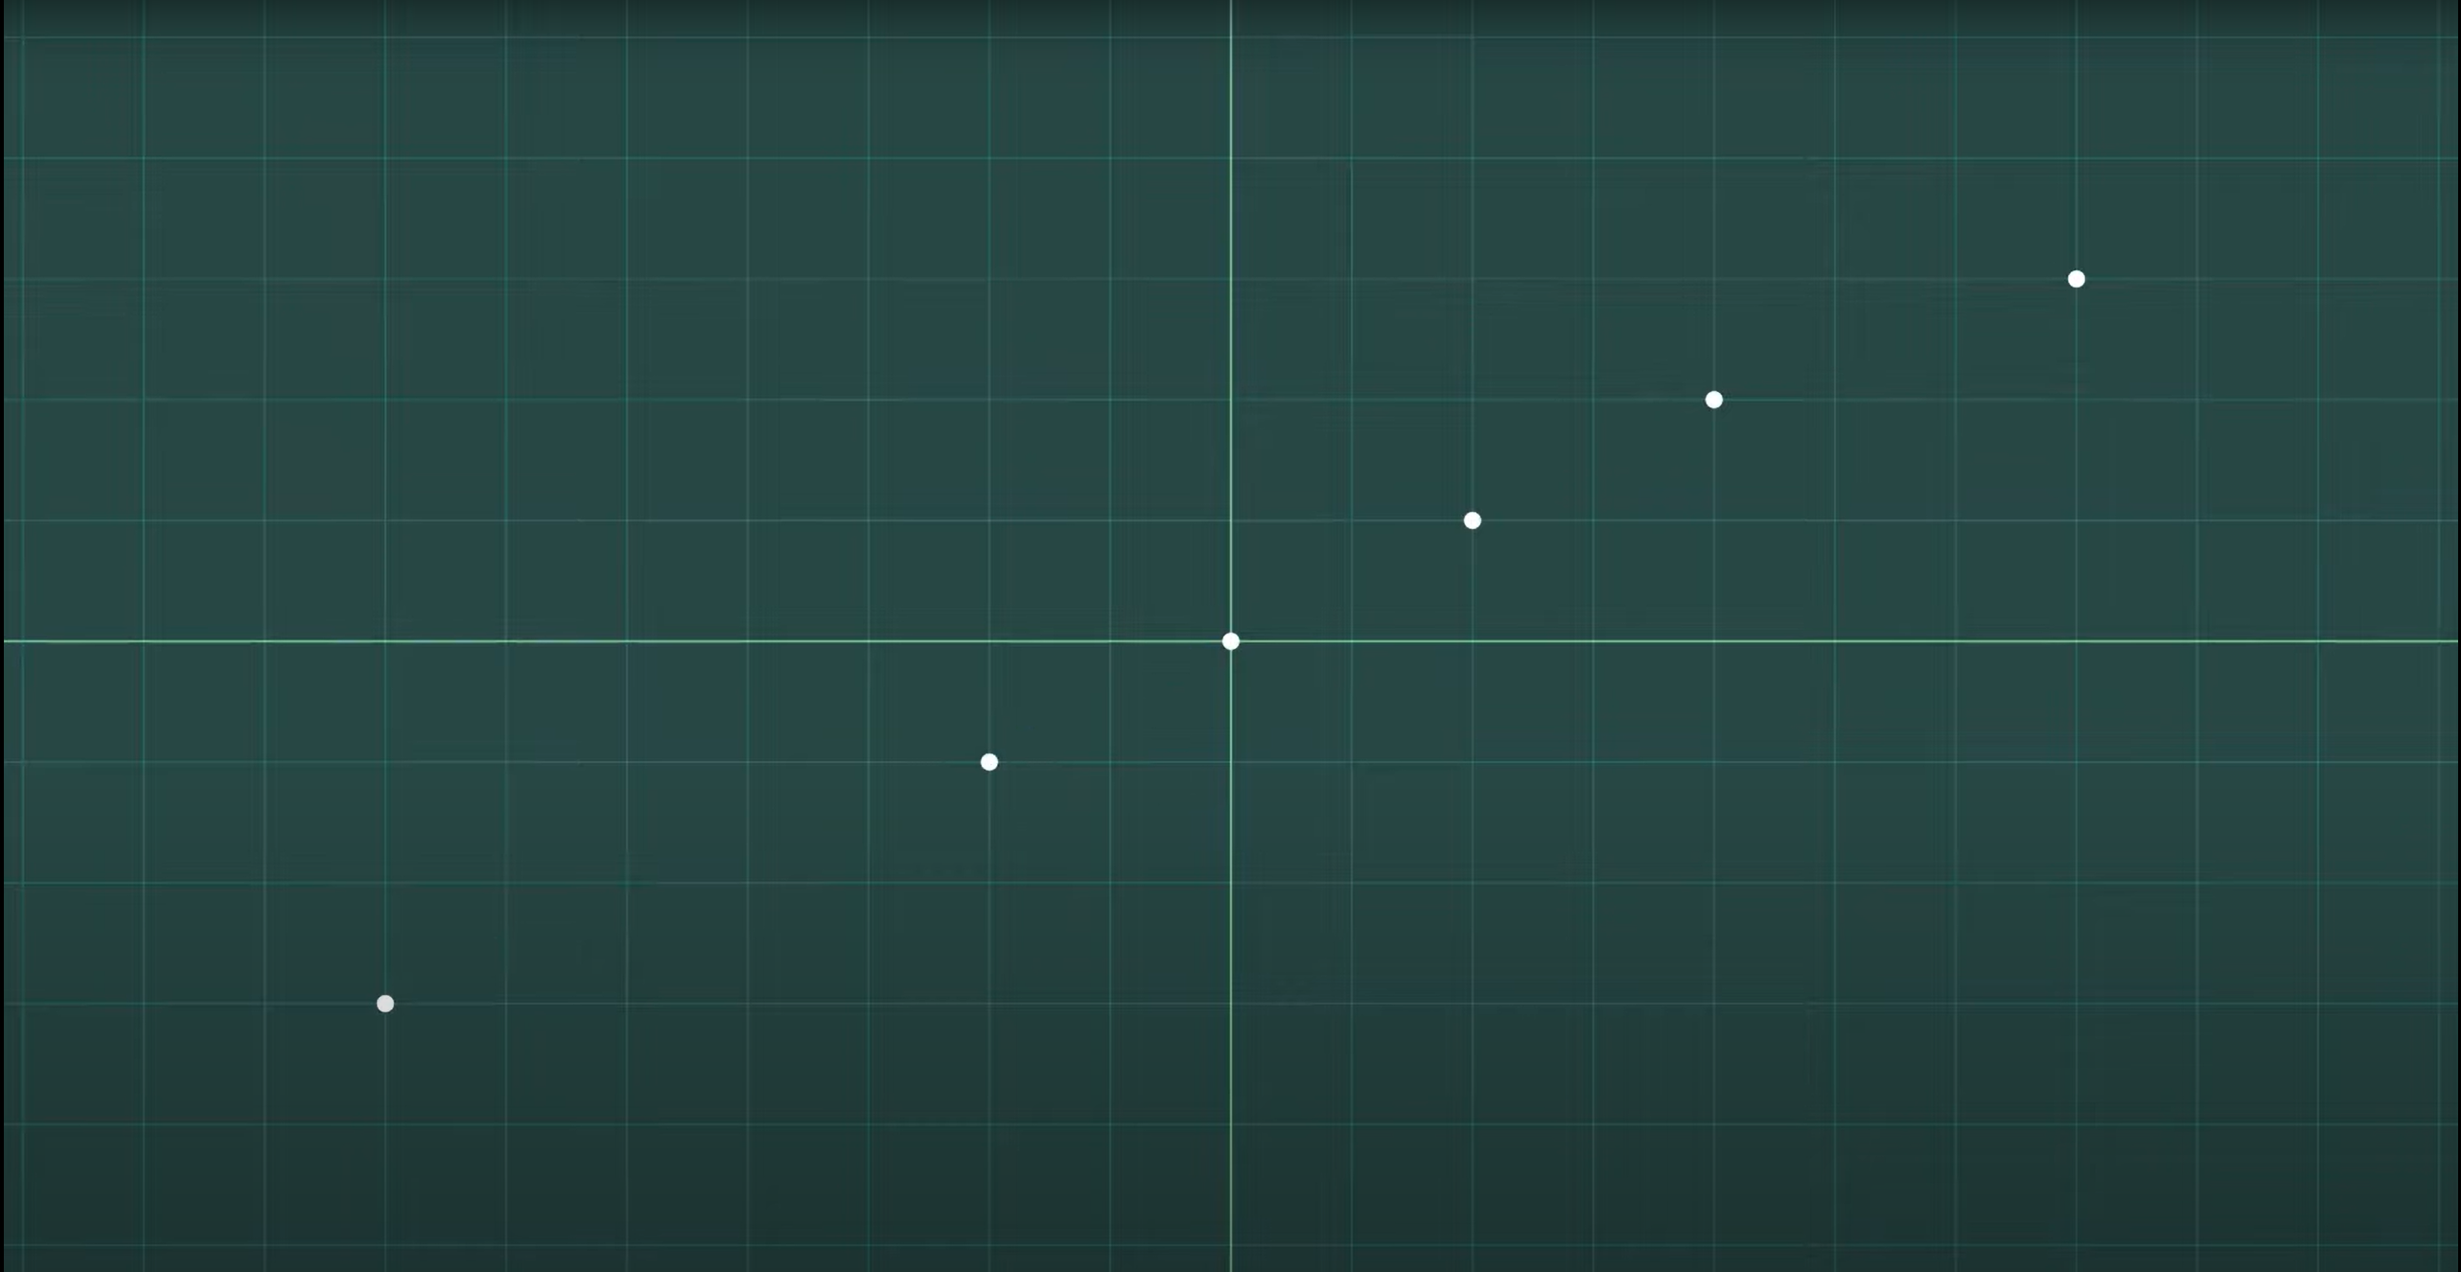
At first, they look to be creating points on a line

Slide 16
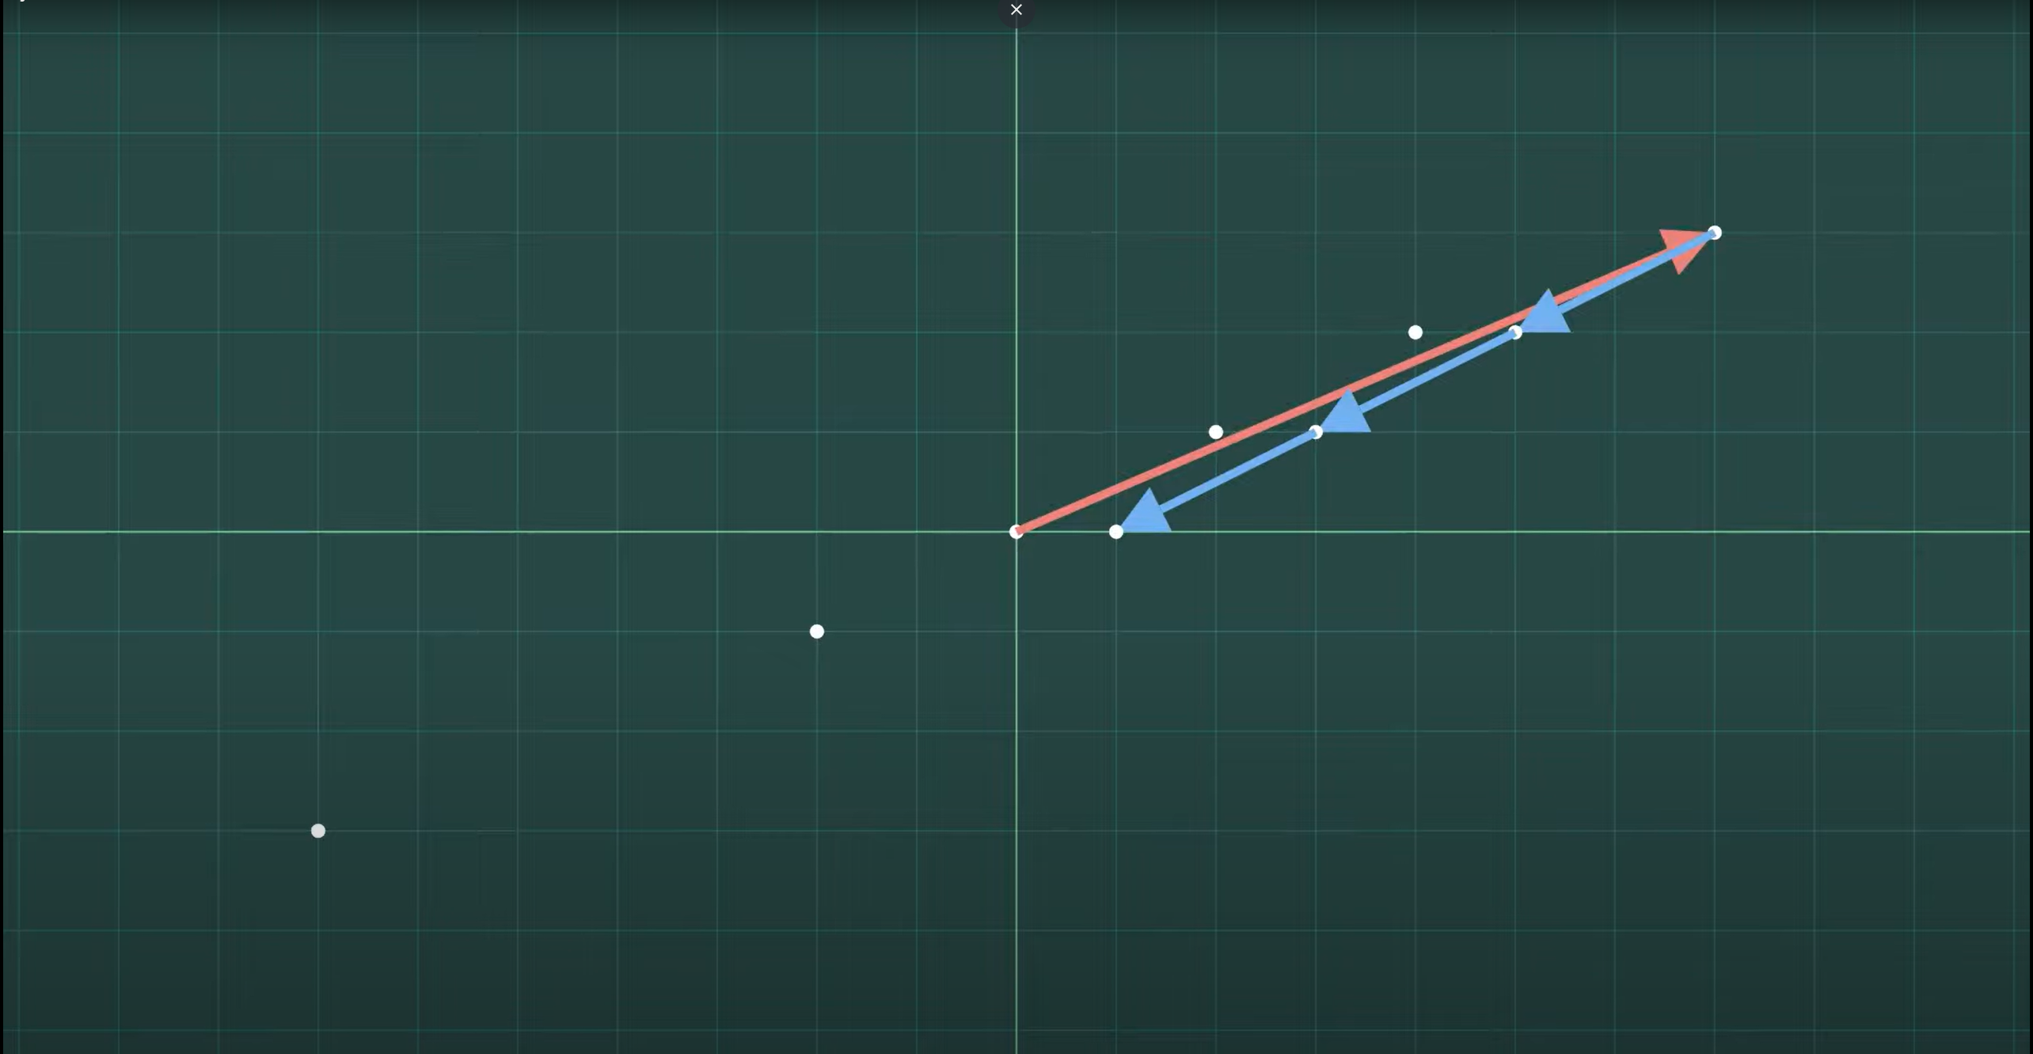
But if we start stacking together the + and – vectors, we get other points

Slide 17
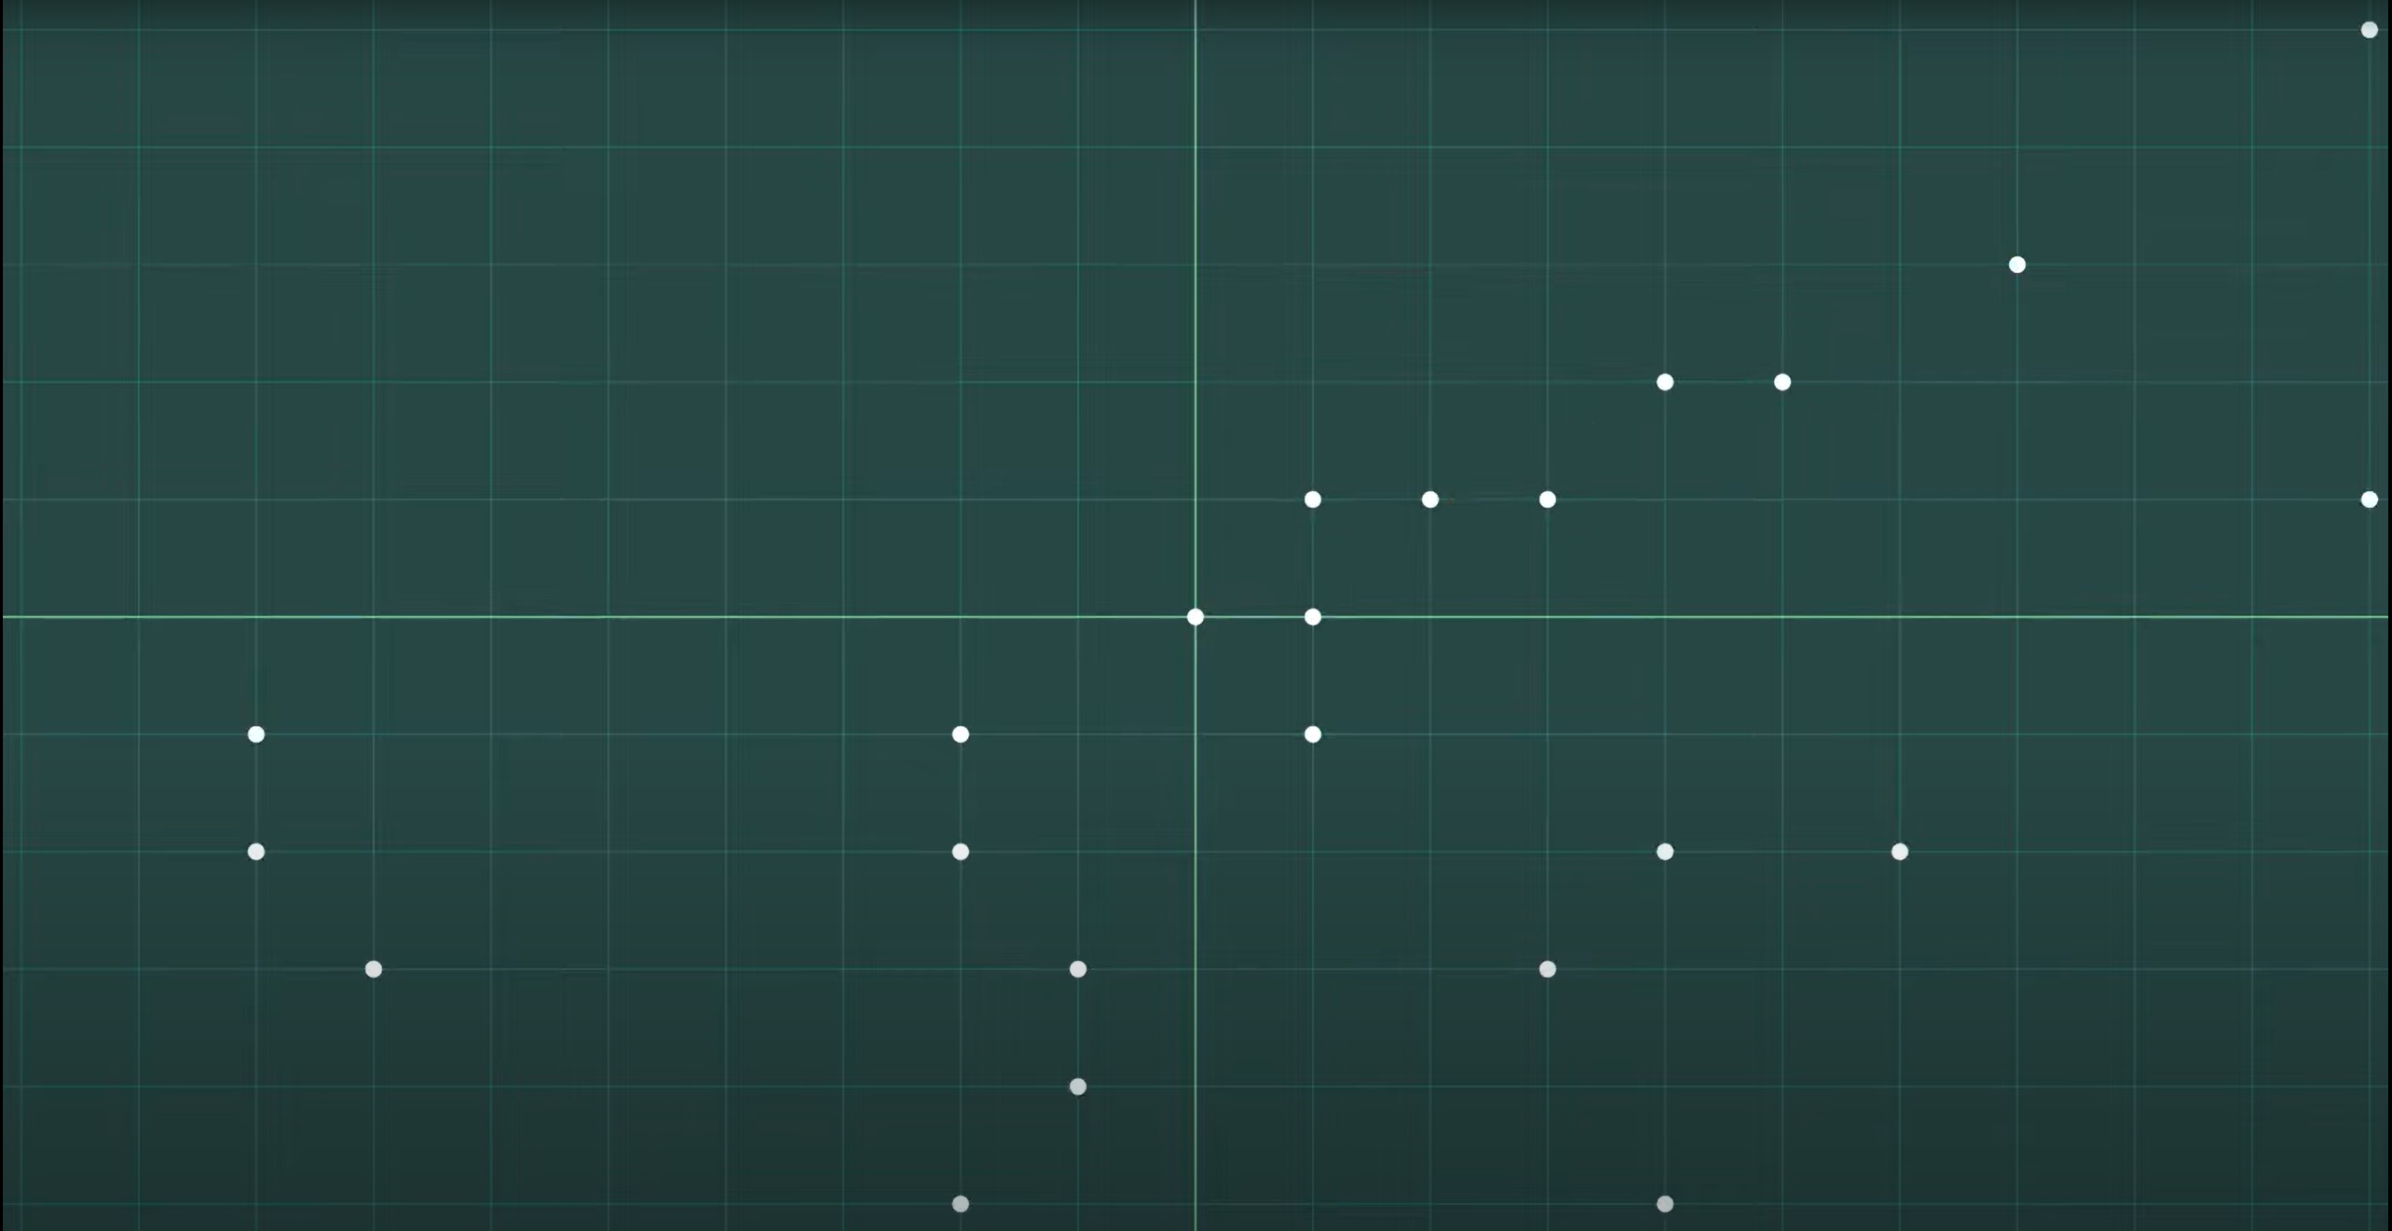
And eventually, ends up with the same square lattice

Slide 18
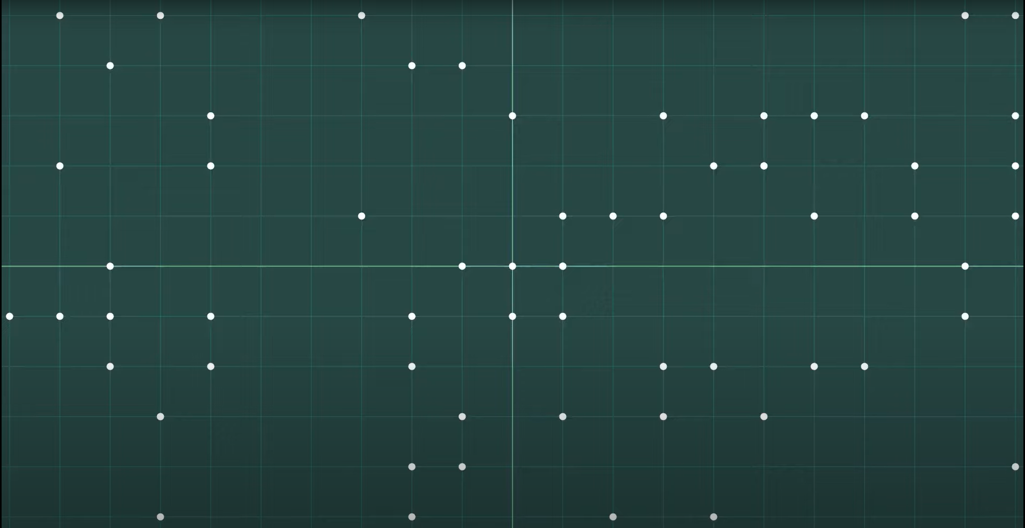
And eventually, ends up with the same square lattice

Slide 19
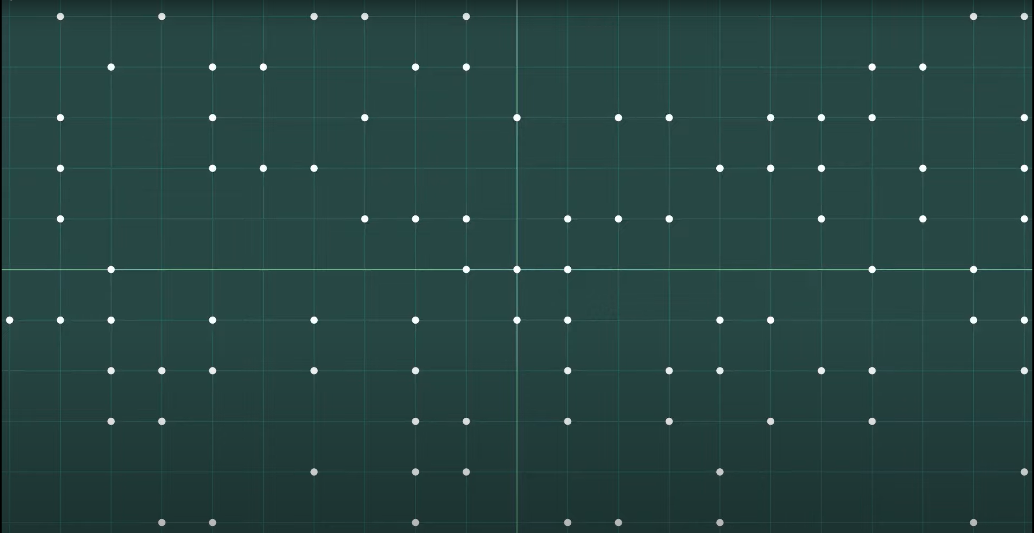
And eventually, ends up with the same square lattice

Slide 20
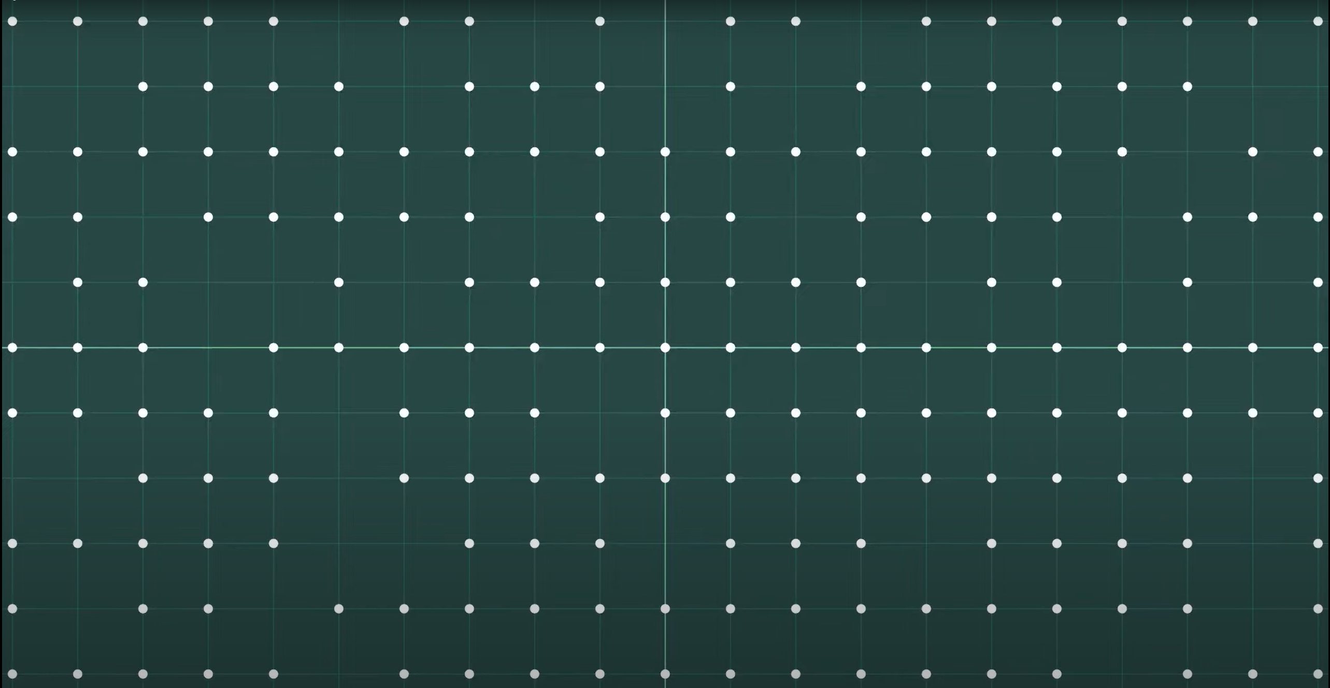
And eventually, ends up with the same square lattice

Slide 21
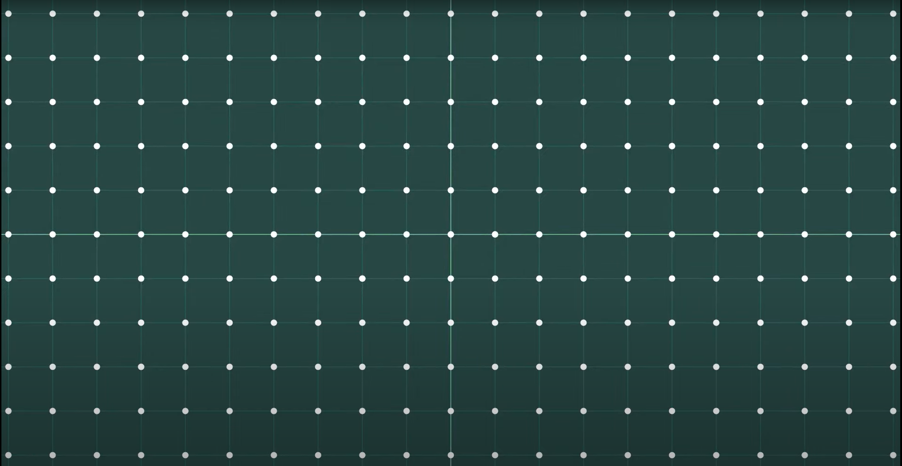
This illustrates an important point:

Slide 22
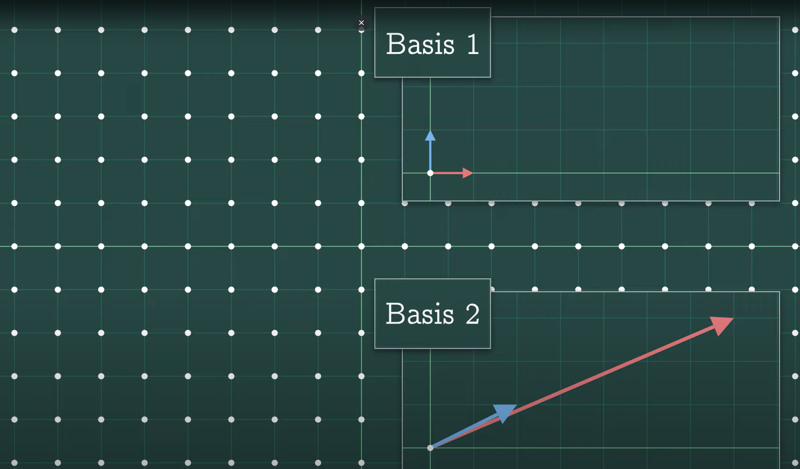
Two very different looking sets of basis vectors can generate the same lattice

Slide 23
Those examples are just very easy to describe
It’s all the points with integer or whole number coordinates. But in general, it’s not so easy to do that
–to describe all the points in a lattice-
Except to say that
“It’s the lattice generated by these vectors”

Slide 24
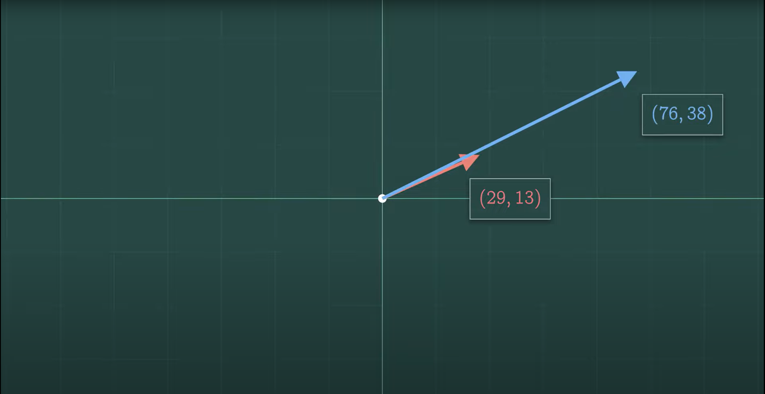
For example: What does the lattice generated by these vectors look like?

Slide 25

We can start to fill in some points at the end of the basis vectors

Slide 26
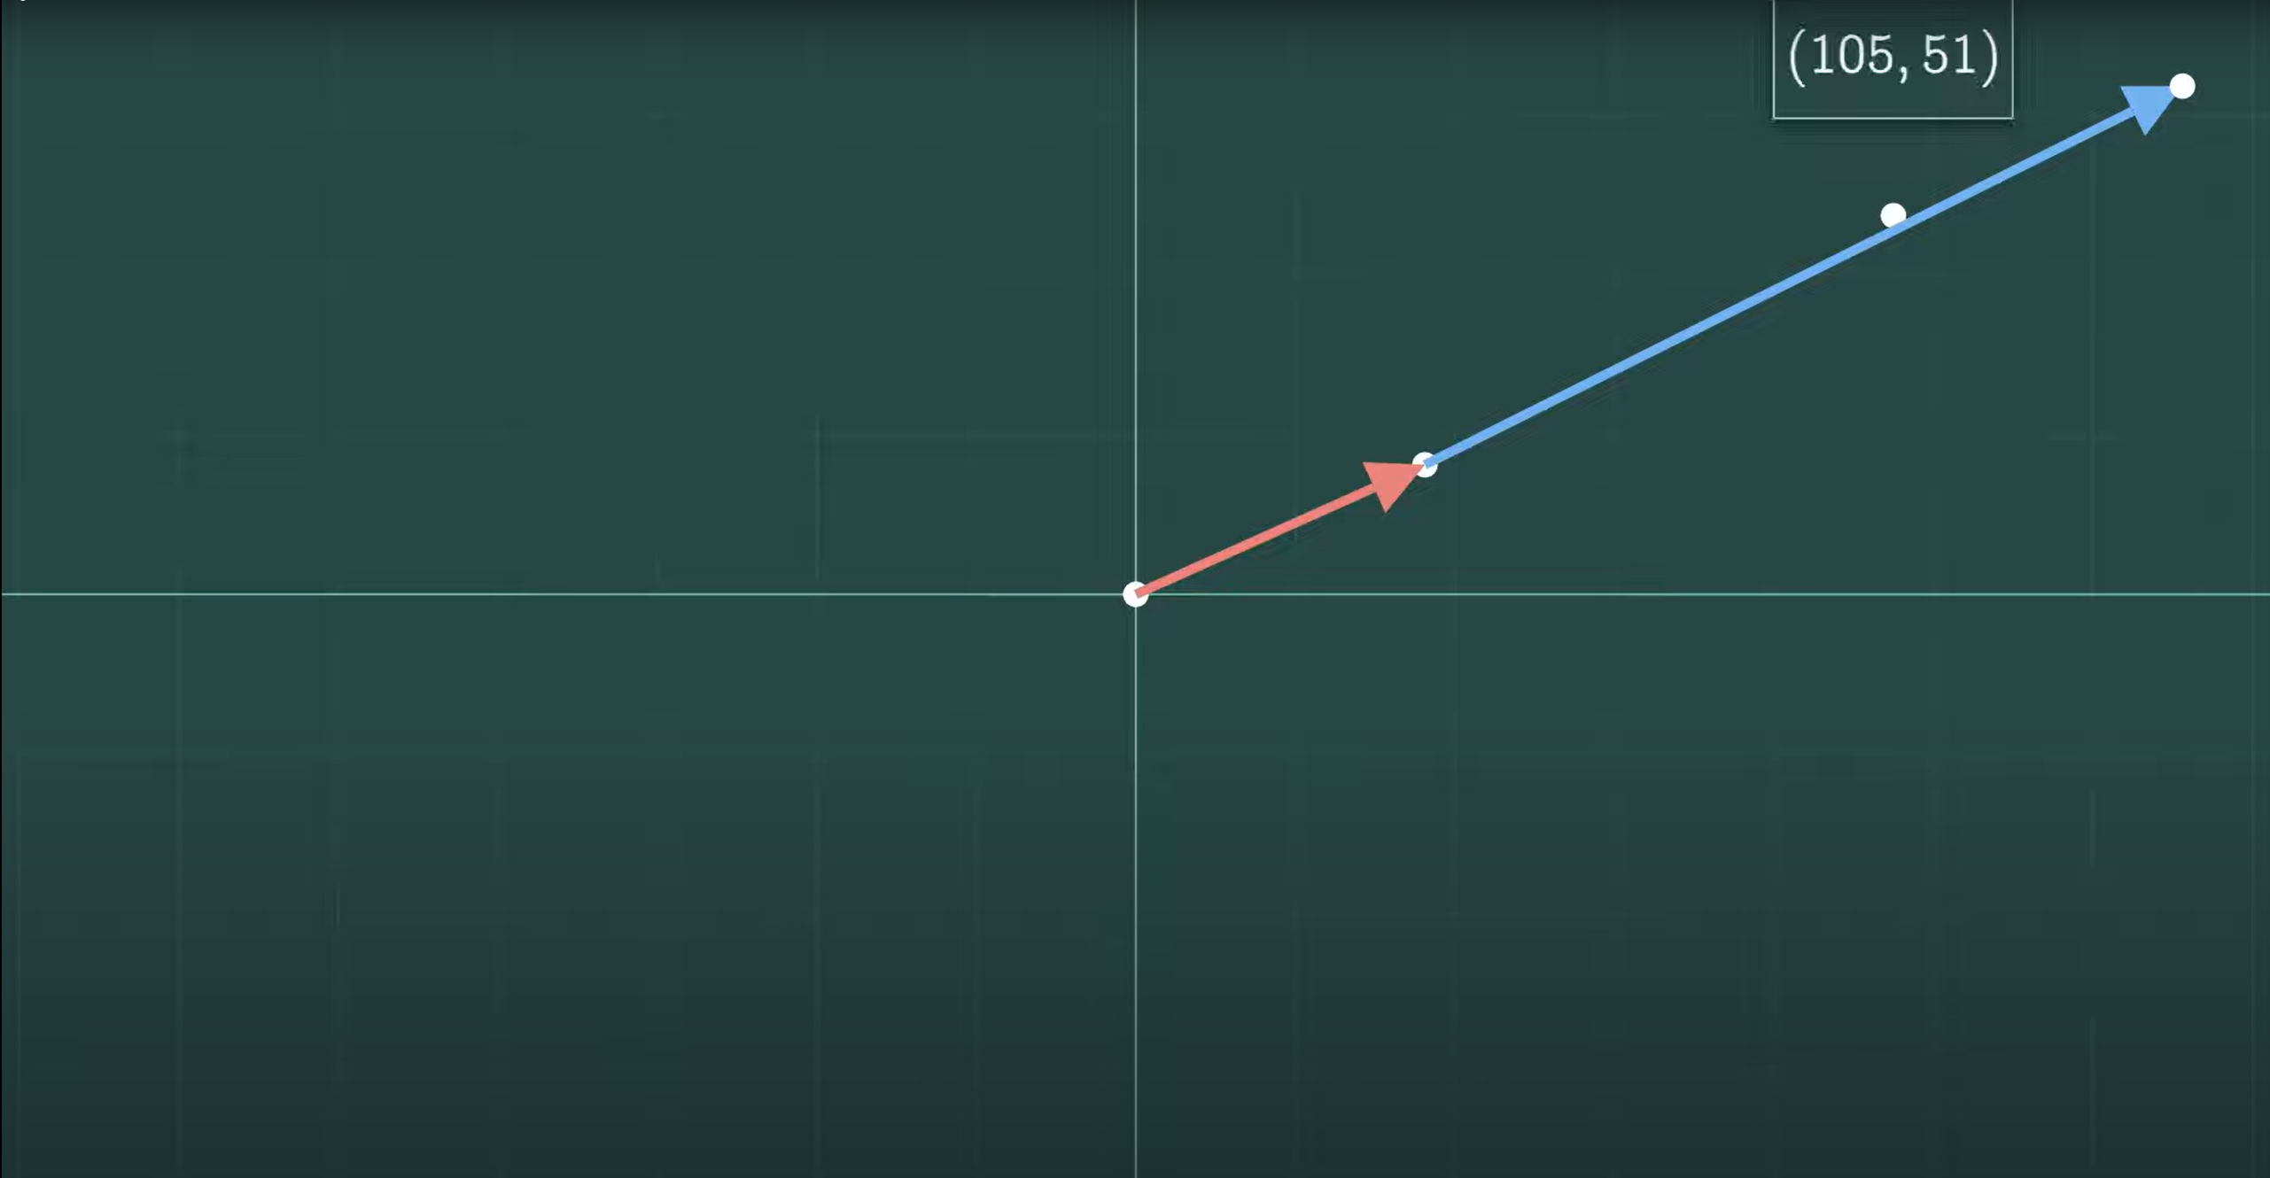
We can add them together to get (105, 51)

Slide 27
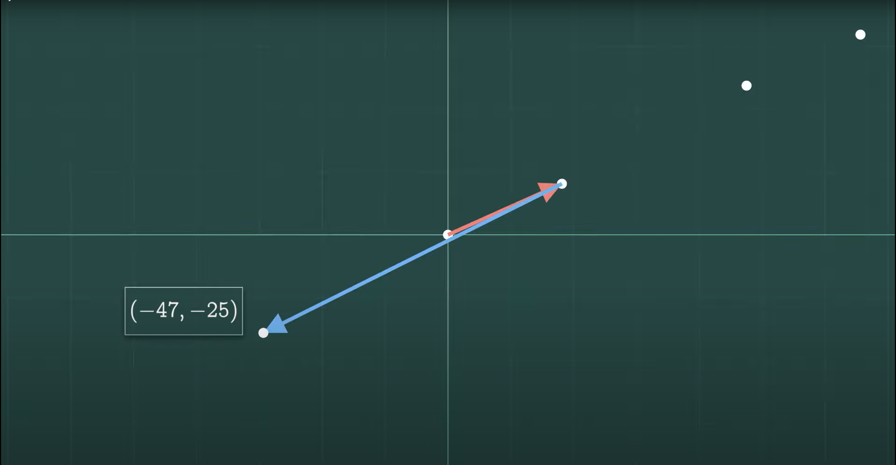
Or we can take red minus blue to get (-47, -25)

Slide 28
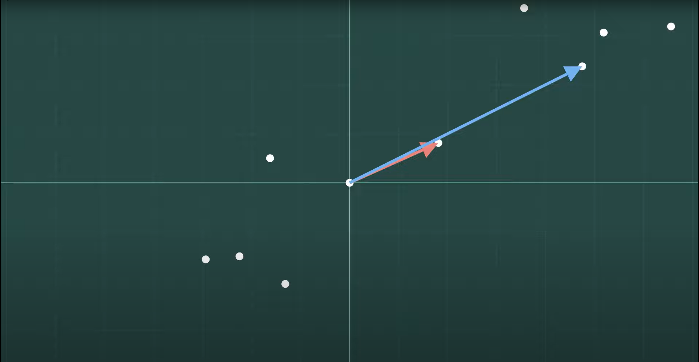
We can start building up individual points. But the whole picture isn’t necessarily obvious.

Slide 29
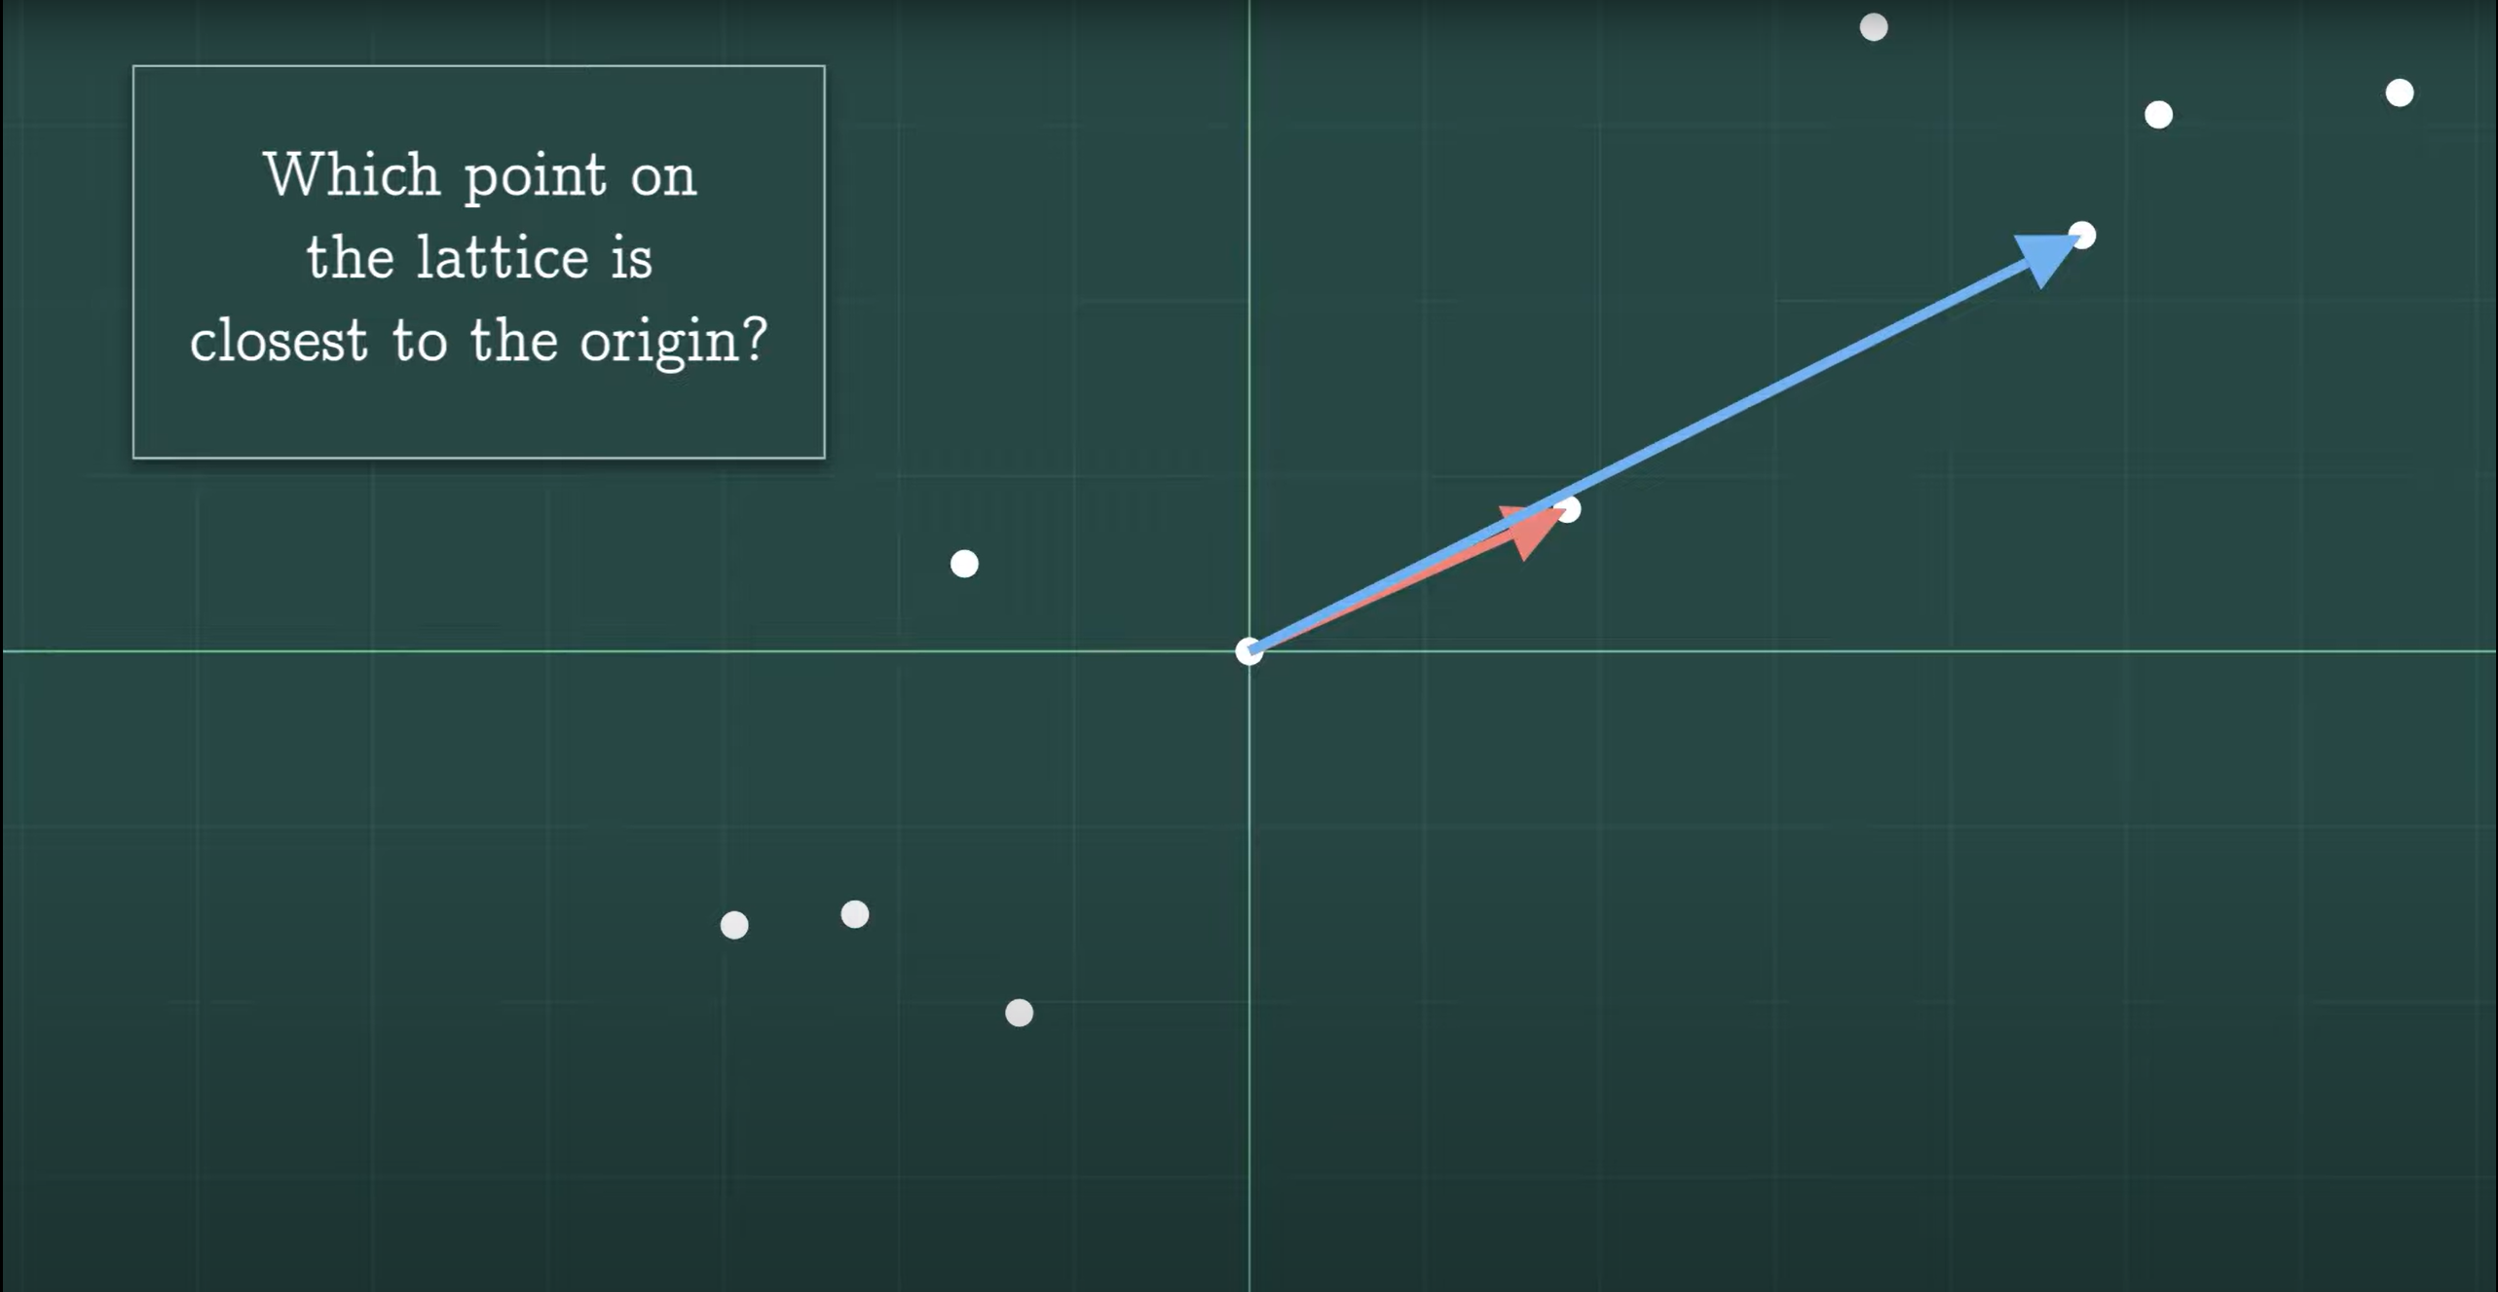
Here’s a surprisingly hard question:
Not including the origin (0,0)

Slide 30
Another: Which combination of the vectors is closest to (0,0)?
Not including the origin (0,0)

Slide 31
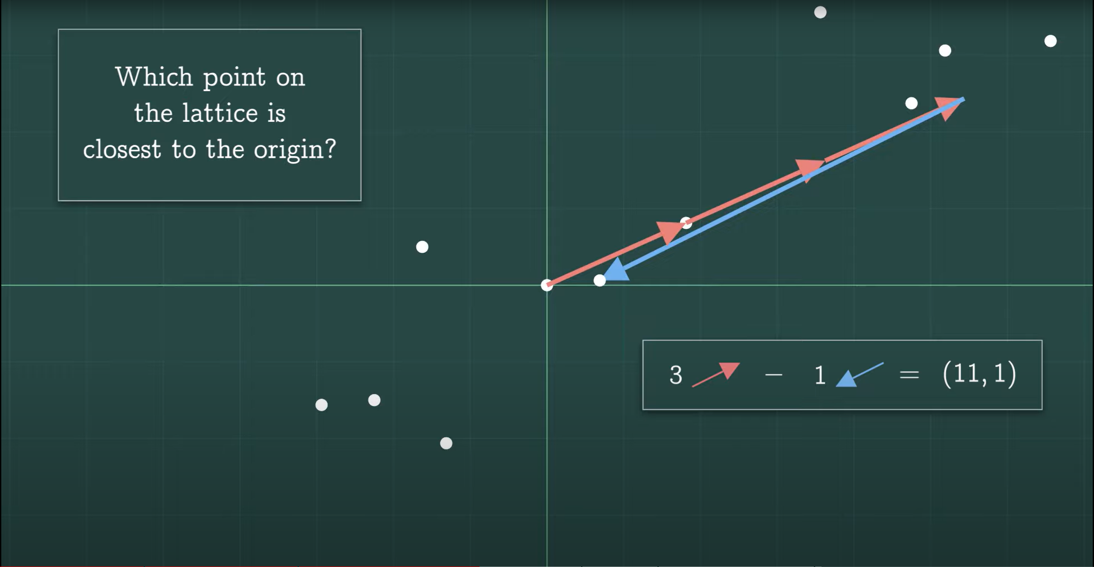
The answer is (11, 1) but can we do better?

Slide 32
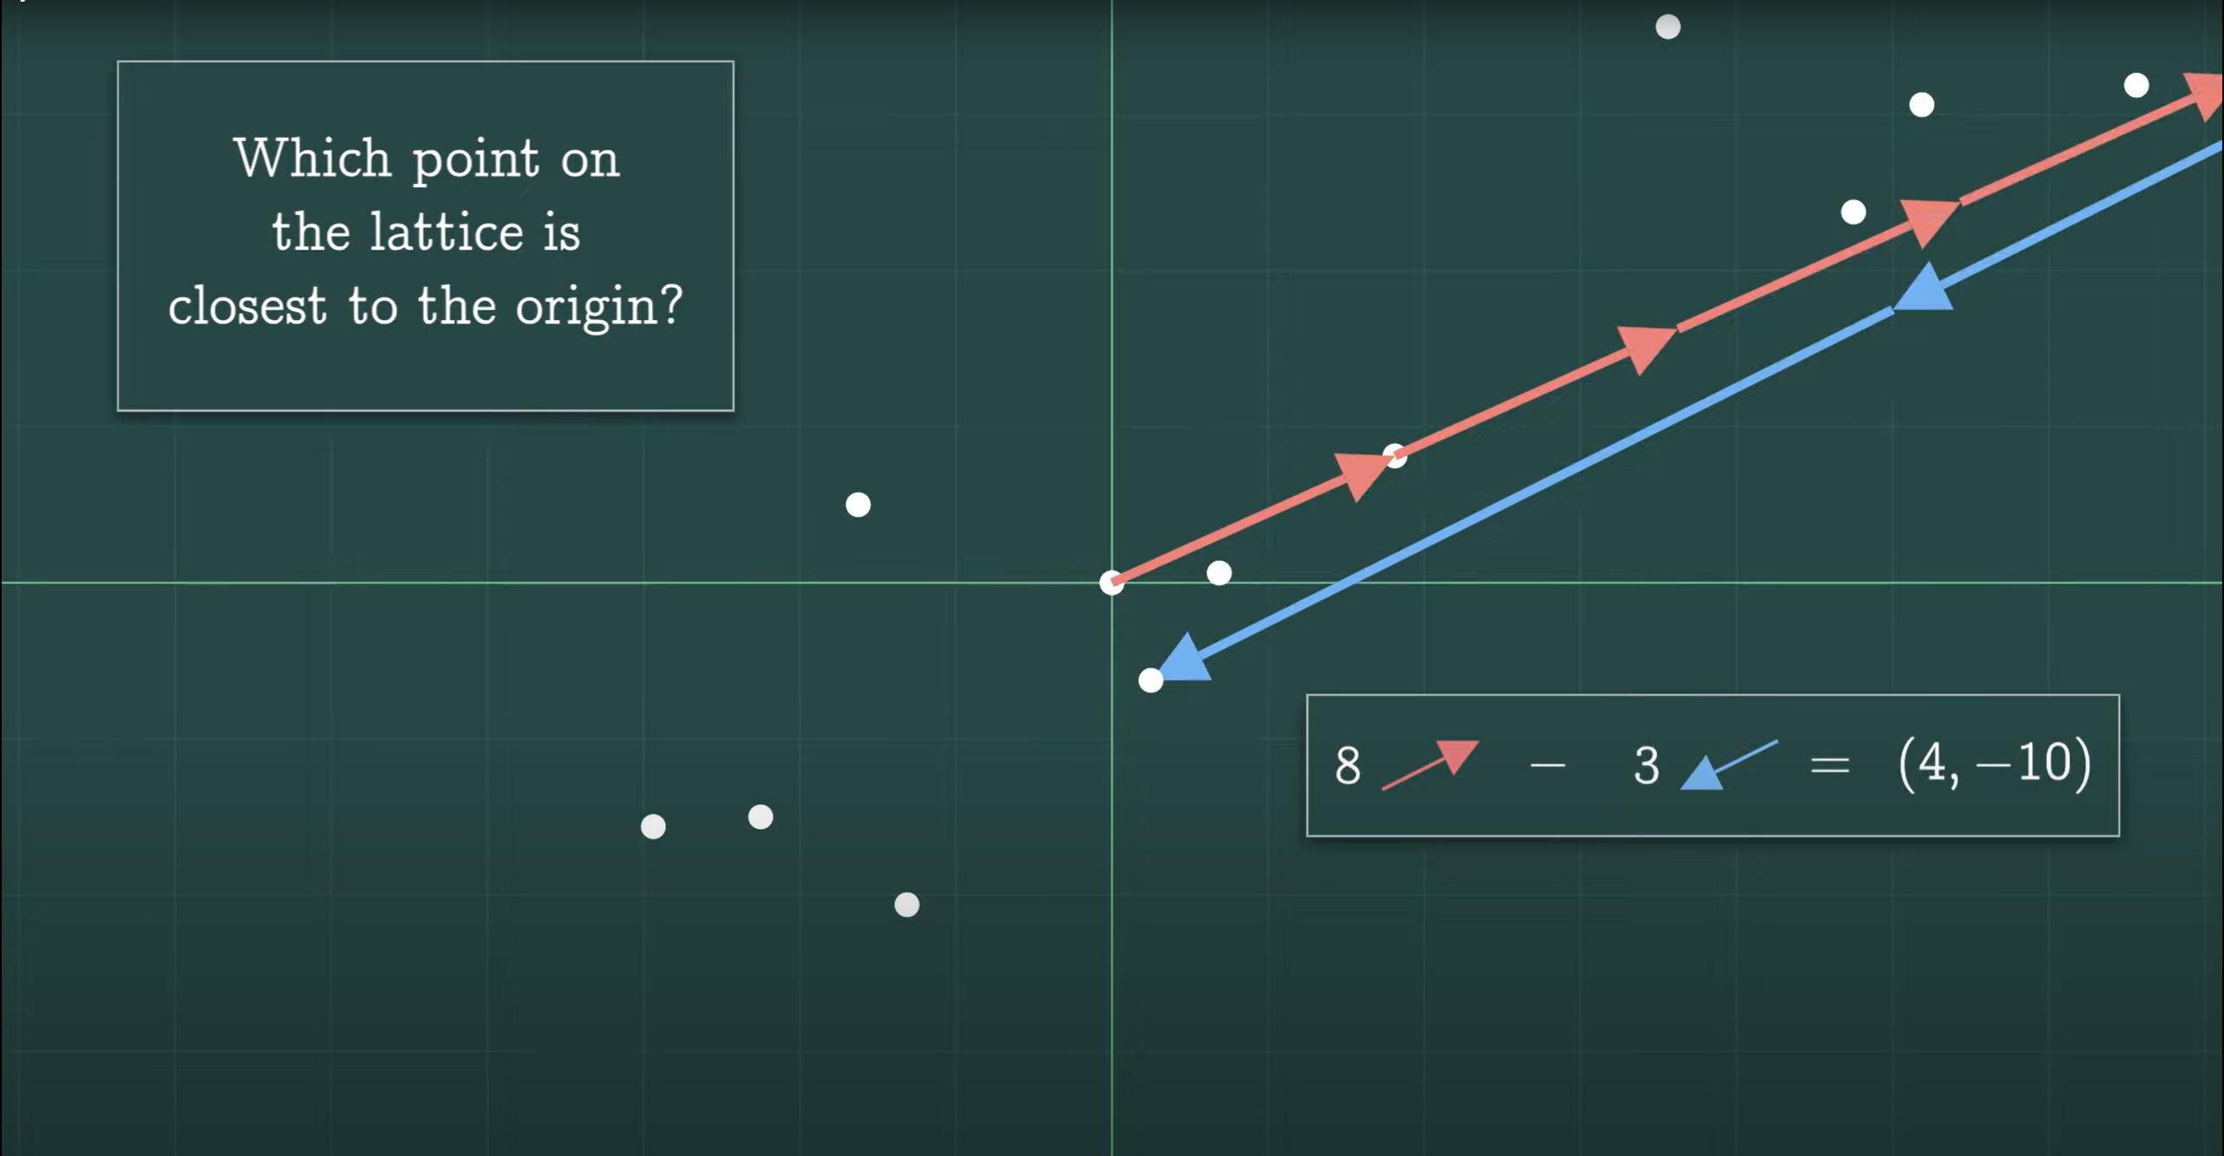
Yes, (4, -10)

Slide 33
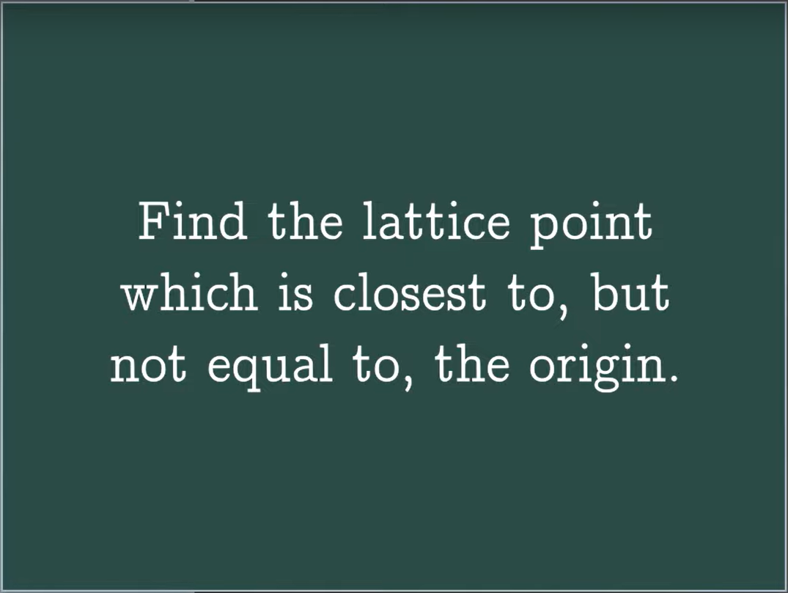
What we did is the shortest vector problem

Slide 34
In a two-dimensional lattice, you could probably reason your way to a solution, but the shortest vector problem gets very hard in higher dimensions.

Slide 35
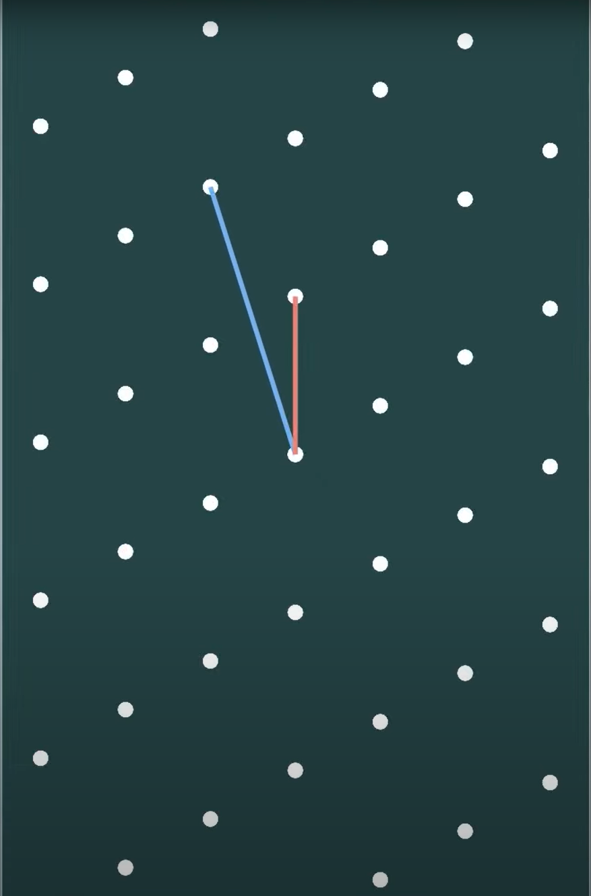
Two-dimensional lattice

Slide 36
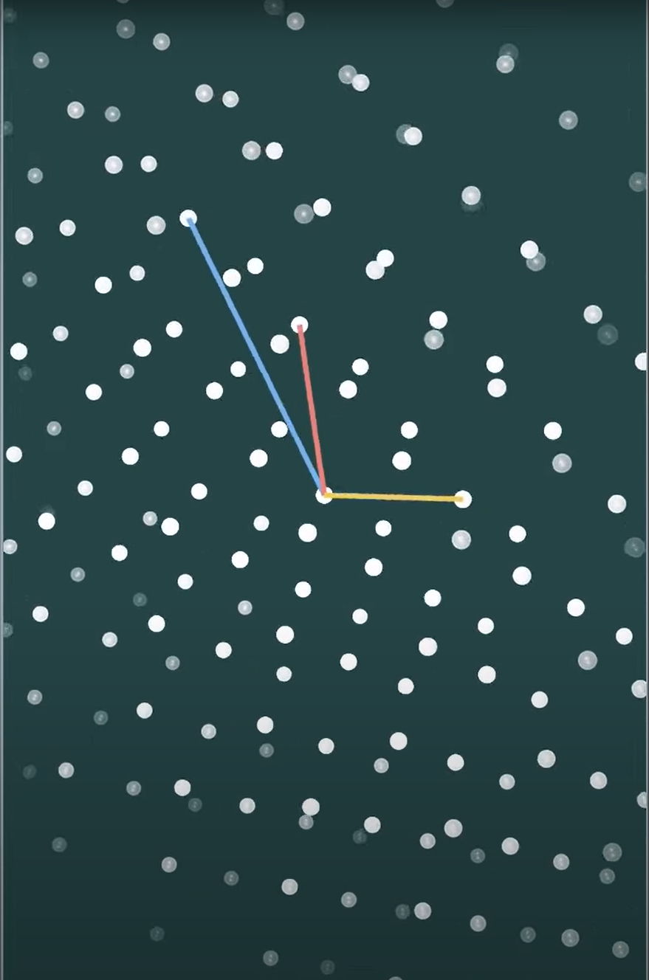
Three-dimensional lattice
Notes:
And a 17 basis vectors gives you a 17-dimensional lattice.

Slide 37
There are more possibilities in higher dimensions, and the shortest vector problem gets even harder.

Slide 38
Closest vector problem
Find the lattice point which is closest to a particular point in space.
Notes:
The shortest vector problem is similar to the closest vector problem.

Slide 39
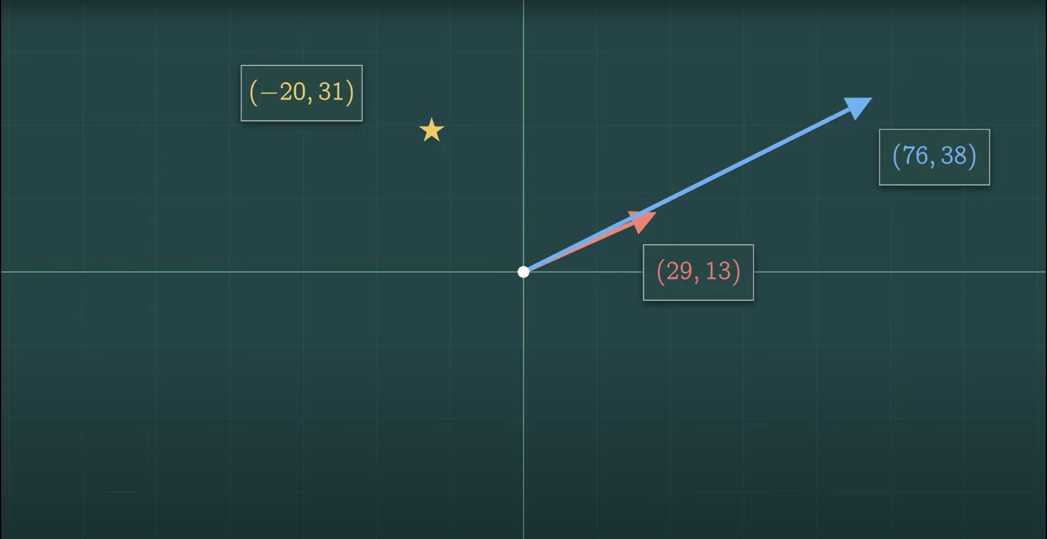
Ex. Which point on the lattice generated by the two vectors (29, 13) and (76, 38) is closest to (-20, 31)?

Slide 40
These belong to a collection of related problems known as “lattice problems”, which experts believe to be hard problems, especially in hundreds and thousands of dimensions. In other words, it would take a very long time for a computer to solve the shortest or the closest vector problems. And importantly for our purposes, computer scientists also believe that it would be very difficult for a quantum computer to solve these problems.

Slide 41
That makes these problems good candidates for the mathematical basis for a quantum-secure cryptographic protocol.

